Slide 1









Welcome!
APAMSA GENERAL MEETING #8

Slide 2

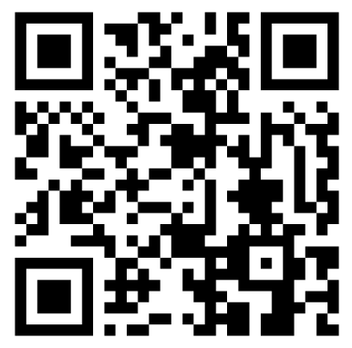


Sign in!

Slide 3

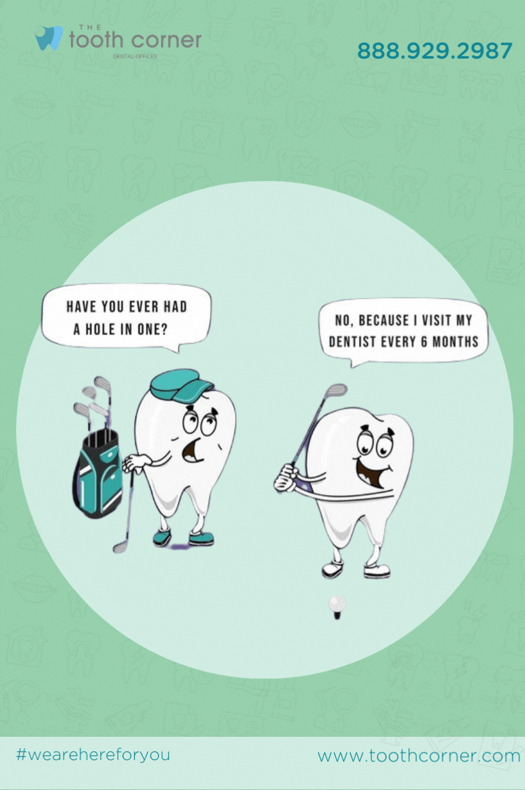


Applying to Dental School!
Apply through the AADSAS; application cycle runs summer to spring
Application consists of:
  DAT score
  Academic history
  Personal Statement
  Letters of Rec
  Experiences (shadowing, volunteering, clinical, research, etc.)

Slide 4
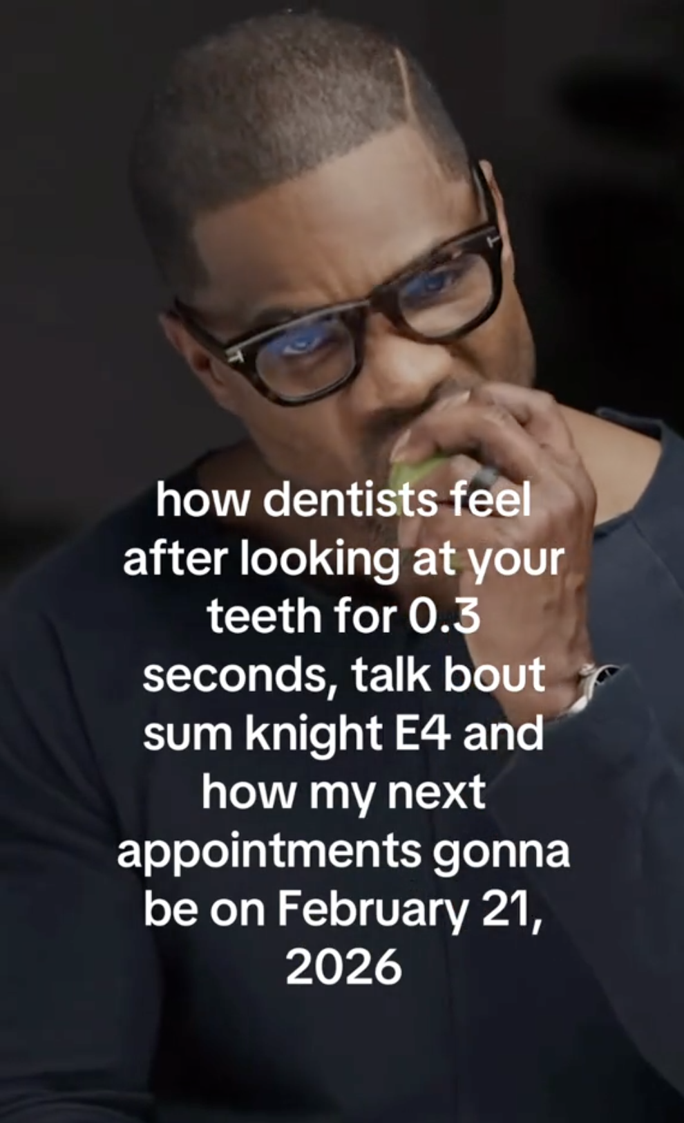



Let’s Learn Some Dentistry Basics!

Slide 5
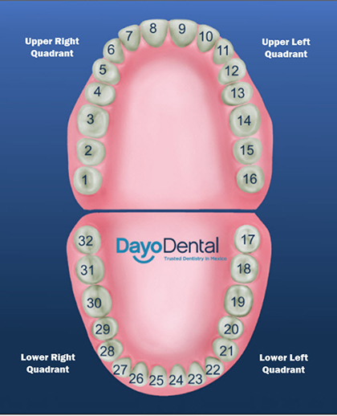


Tooth Numbering
Starting from the back top right (your right)
Move left across your top row
Shift down to bottom row
Move right across your bottom row
Wisdom teeth included

Slide 6
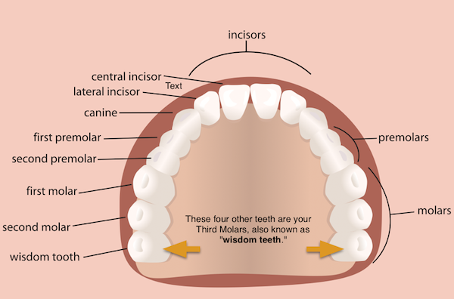
Types of Teeth
Incisors
  Central incisor
  Lateral incisor
Canines
Premolars
  1st premolar
  2nd premolar
Molars
  1st molar
  2nd molar
Wisdom tooth

Slide 7
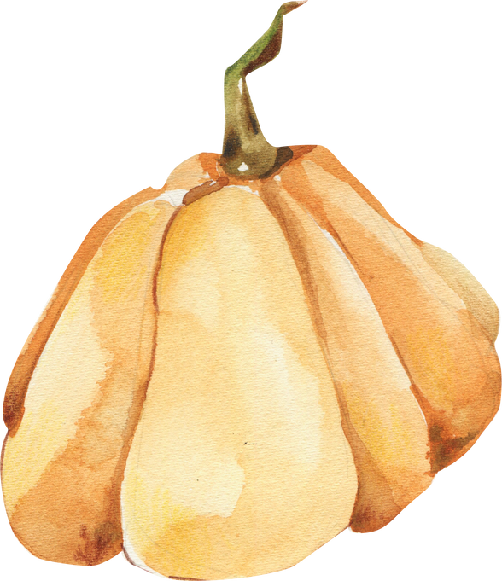
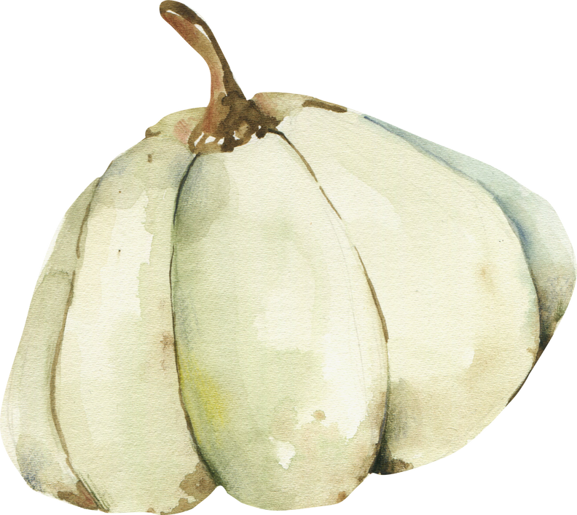

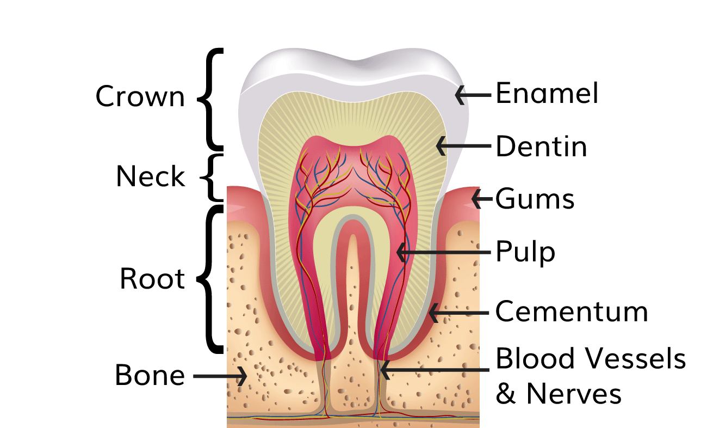
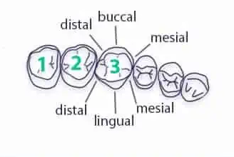
Sides and Parts of a Tooth
Cheeks…
Back of
mouth
Front of Mouth
Tongue 👅👅👅

Slide 8
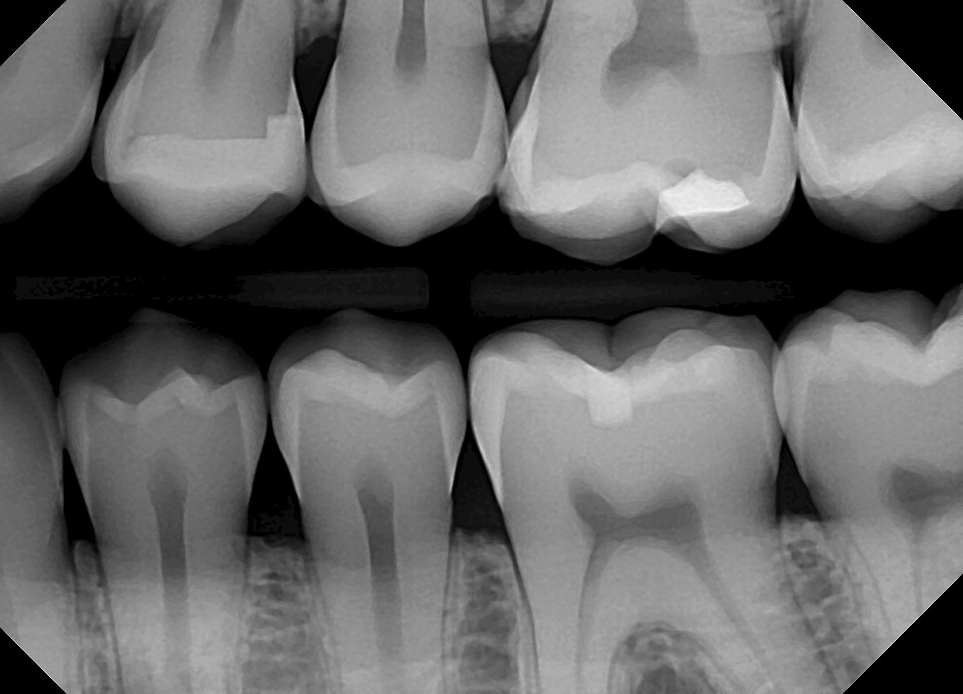


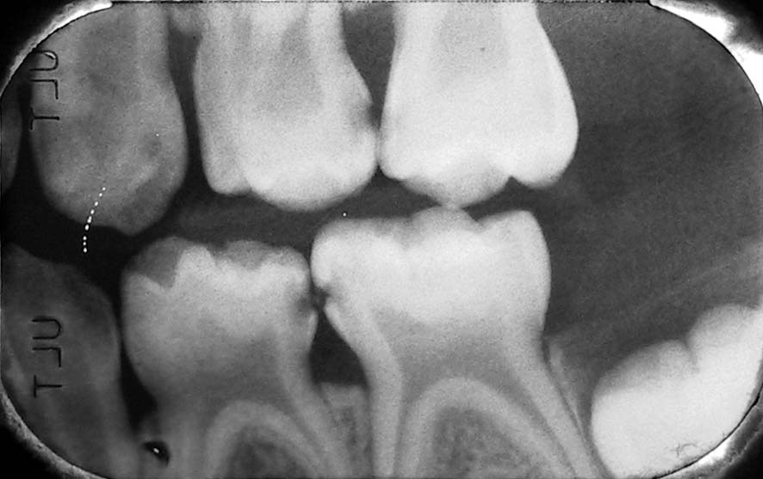

886 × 557
Cavities & X-Rays
Cavities
X-Rays
normal bitewings
Basically when bacteria’s in your mouth release acids as a byproduct that eat away at your enamel, making it weaker and making your whole tooth more prone to damage
Capture the “Density” of a tooth
Lighter areas = more stuff
Darker areas = Less stuff = CAVITY!!!!!!!!!!!
  Esp. common in between teeth when you don’t floss………….. are you flossing?
Bad…
Can you spot the cavities?

Slide 9

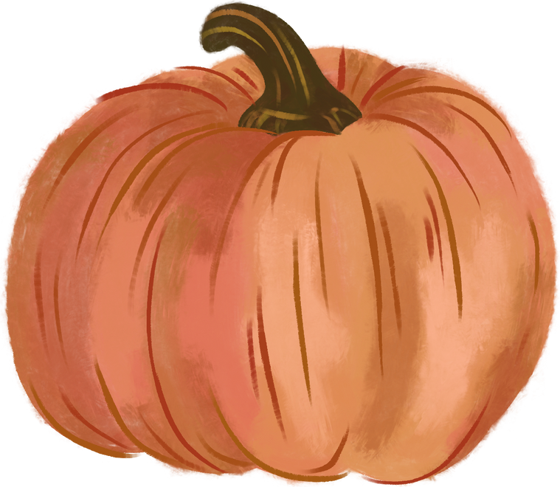
Practice With a Case Study!

Slide 10
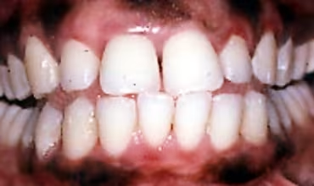
Case Study!
29 y/o female; chief complaint = “My gums bleed when I brush.
I have sensitivity to hot and cold most of the time.”
Info:
Normal bp, rr, and pulse
family history includes diabetes, hypertension, oral cancer, alcoholism and substance abuse
Recently smokes a pack of cigarettes daily
Dental History:
Her last dental visit was over ten years ago- wisdom tooth.
She rinses with a phenol mouthrinse several times daily but mixes it with water to reduce the burning sensation.
She uses a medium bristled toothbrush once daily but has never flossed or used other interdental aids.
She is not sure if her toothpaste contains fluoride.

Slide 11
Case Study!
Based on all that info, what diagnosis can be made?
Diagnosis:
Gingival inflammation and bleeding Chronic Gingivitis
Pigmentation around gums Smoker’s Melanosis
Sensitivity From improper brushing and oral hygiene
Management:
Comprehensive dental cleaning — remove plaque
Patient education — proper brushing technique, flossing, and smoking cessation counseling
Discontinue phenol mouthrinse — replace with alcohol-free fluoride rinse
Fluoride toothpaste — to manage sensitivity
Follow-up after a few weeks to see if there’s improvement

Slide 12



Write your topic or idea
  Presentations are communication tools that can be used as demonstrations, lectures, speeches, reports, and more. It is mostly presented before an audience.

Slide 13
Practice Manual Dexterity by Painting Pumpkins!

Slide 14
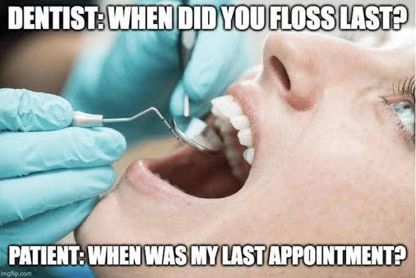
Announcements!

Slide 15

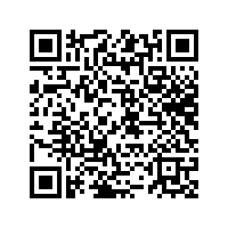
MERCH

Slide 16
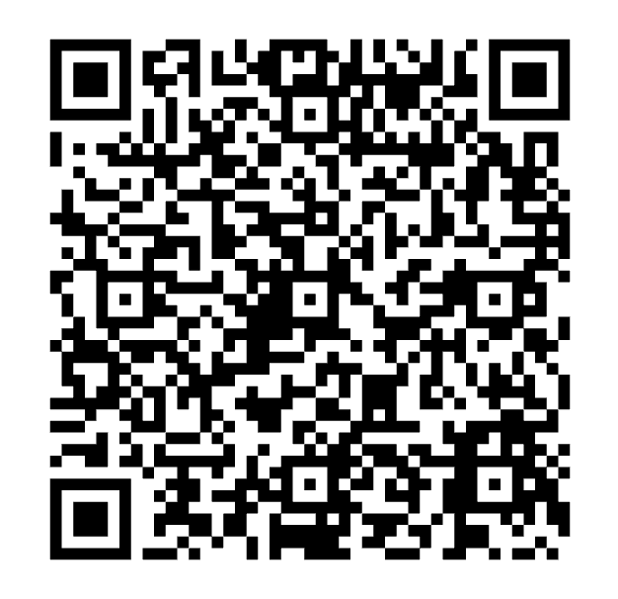
Interview Prep Workshop Interest!

Slide 17
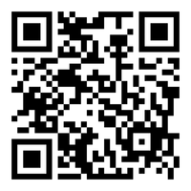
Volunteer at the Food Bank!
November 22, 2025
9 am - 12 pm
3003 S Country Club Rd Tucson, AZ 85713
  RIDES PROVIDED!!!!!
LIMITED SPOTS!
ONLY 9 LEFT

Slide 18
mentorship program updates!
check your emails! all matches have been emailed out
come talk to megan if you have any questions/did not receive the email
please check your spam and dig through your inboxes (the email comes from medowd@arizona.edu)

Slide 19
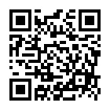
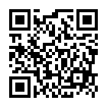
afamsa program
preference forms!
preference forms have been emailed out and will be due oct 29th at midnight!
come talk to megan if you have any questions/did not receive the email
please check your spam and dig through your inboxes (the email comes from medowd@arizona.edu)
LITTLES PREF FORM
BIGS PREF FORM

Slide 20
afamsa family REVEAL!
please keep an eye out for an email from megan this weekend!
come talk to us if you are not able to make the reveal at the next general meeting (11/3)!

Slide 21
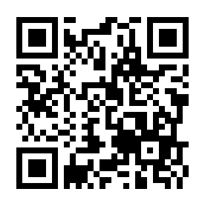
apamsa website

Slide 22

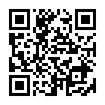
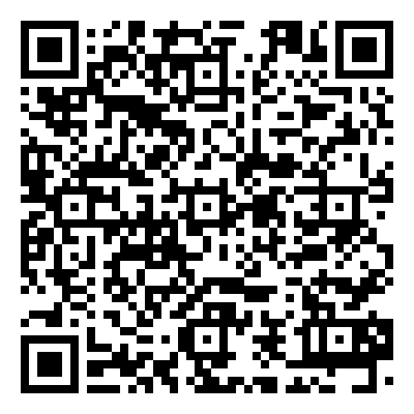

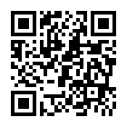
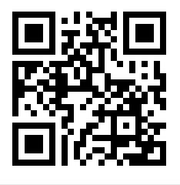

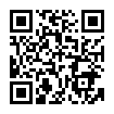




You know where to find us!
LinkTree
APAMSA Memories
Resources galore AND latest APAMSA updates!
Photos!
(Updated after every event)

