Slide 1
Medical School Application
General Meeting 6

Slide 2
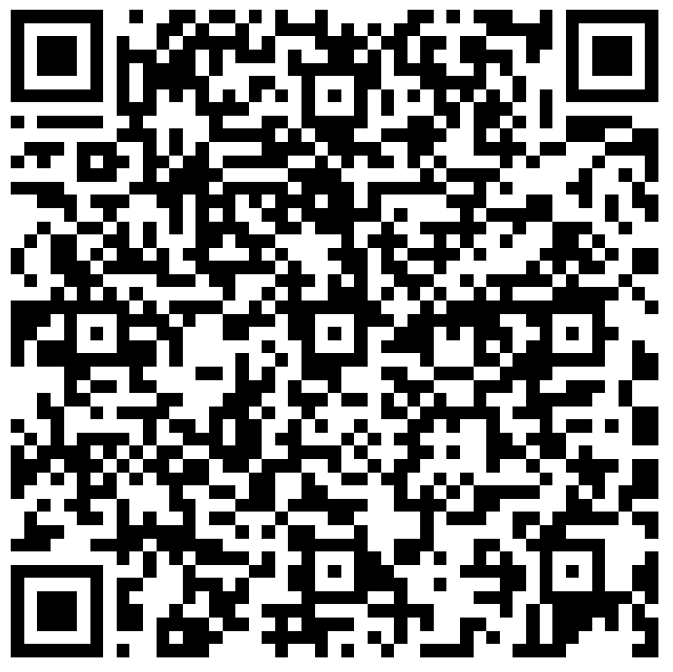
Sign In

Slide 3
Agenda
01
Components of Medical School Application
02
03
Serious Advice
Activity

Slide 4
01
Components of Medical School Application

Slide 5
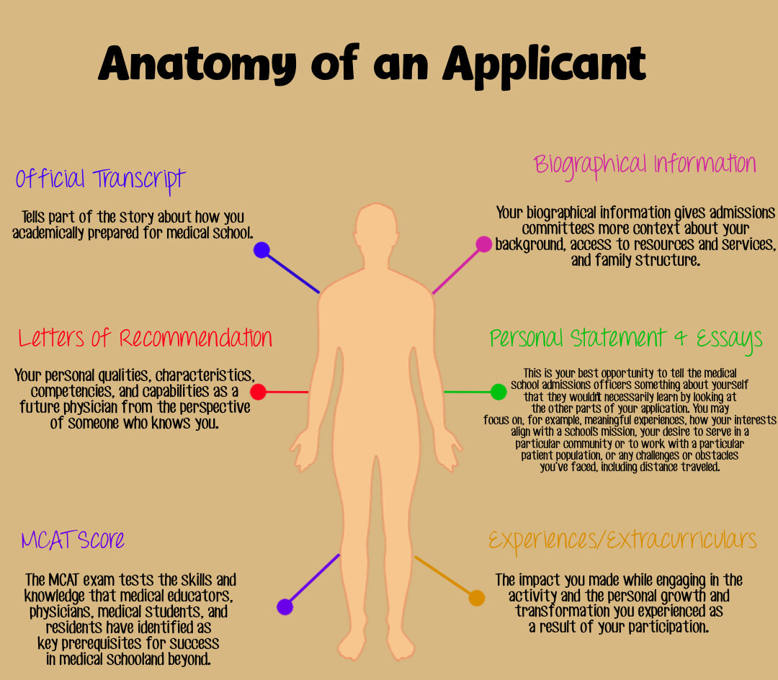
Overview
Medical School Application
Starts when you begin college.
You have a limited amount of time, so it must be invested wisely.

Slide 6
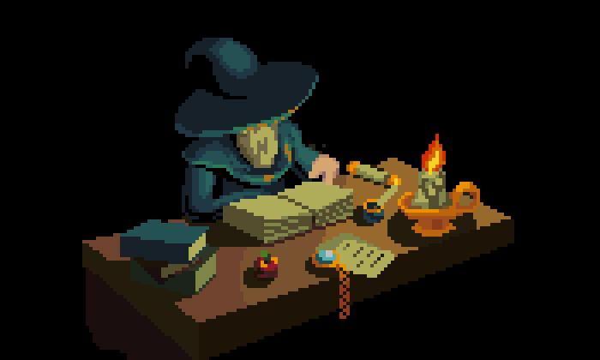
Required Information
Identifying Information
Demographic Information
Biographical Information
Disadvantage Information
Academic Record
Coursework
Colleges attended

Slide 7
Work / Activities Section
GPA
MCAT
Clinical
Research
Volunteer
Leadership
Shadowing
LOR

Slide 8
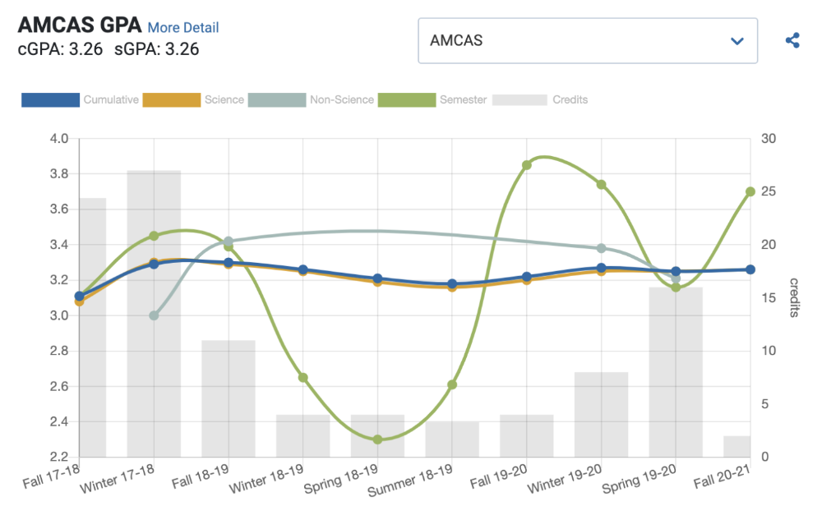
GPA
One of the first things medical schools look at
  Will be the first door you walk through
Two components
  Science GPA
  Cumulative GPA
IMPORTANT DISCLAIMER: Your grades do not define who you are and whether you have a 4.0 or not does not make or break whether you get in!!!!!

Slide 9
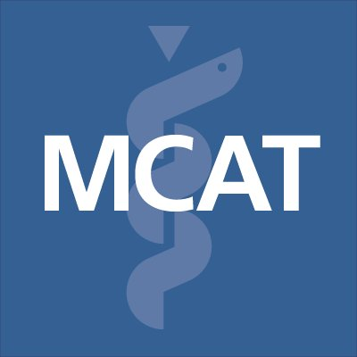


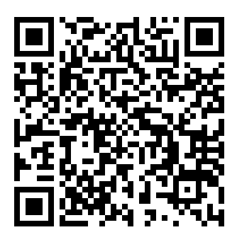

MCAT
Importance
Resources
Premade Anki decks
Kaplan books
AAMC Question Packs
Goes alongside your GPA, this will be one of the first things medical schools screen before they review your application
  7 ½ hour long exam
  4 sections
People spend 3~6 months preparing for this exam
  Lots of variance between individuals in study time as well as study methods
Scan for a detailed guide!!!

Slide 10

TRUE OR FALSE
Medical schools consider other factors as well, and if you only have a good GPA and MCAT with minimal extracurriculars, you won’t be building a very competitive application
  Trade off: More time studying = possible better grades and MCAT score BUT losing time for strengthening other aspects of your application
Also highly dependent on school list
  So many students with high stats only apply to top tier schools
A 4.0 GPA and 528 MCAT will get you into any medical school guaranteed

Slide 11
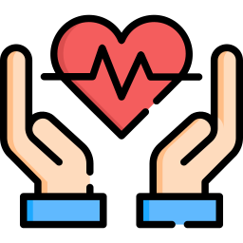
Clinical
Importance
Examples
Certified Nursing Assistant
Phlebotomist
Caretaker
Volunteer
  At a hospice, clinic, etc;
Extremely critical to have
  They demonstrate hands-on patient care experience
  Validation of career choice
Minimum amount 100~150 hours
  Typically would aim for 400+ to be a more competitive applicant
  But quality over quantity
Check out our LinkTree for clinical opportunities.

Slide 12
Research
Importance
Look for labs
Science is the backbone of all medicine.
Thinking and Reasoning Competencies
Aligning with institutional values
Join a lab
Training
Misconceptions
Research project
You have to do research for medical school
Only STEM/medical lab research counts
Poster presentation/
Publication
Research only counts if published

Slide 13
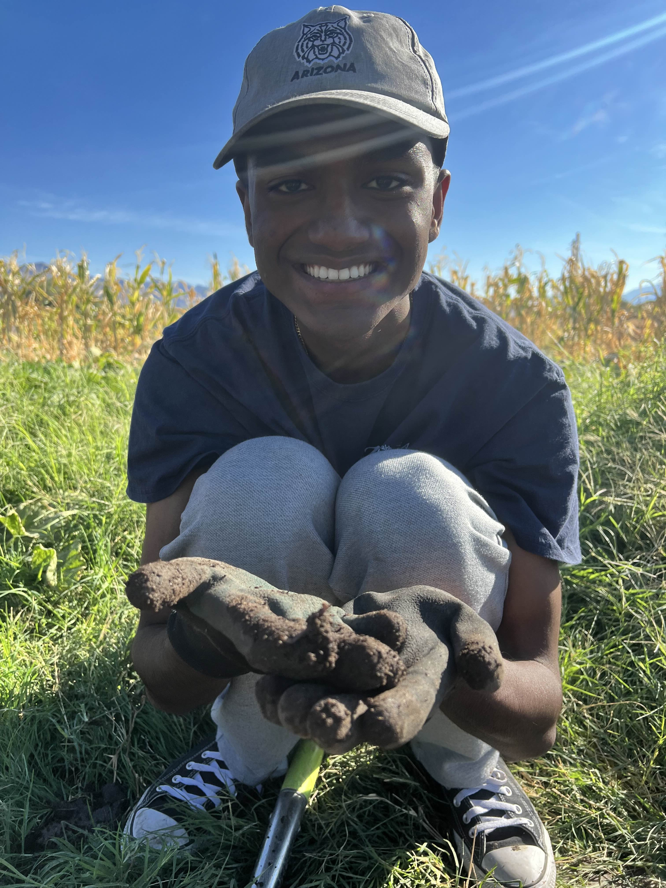
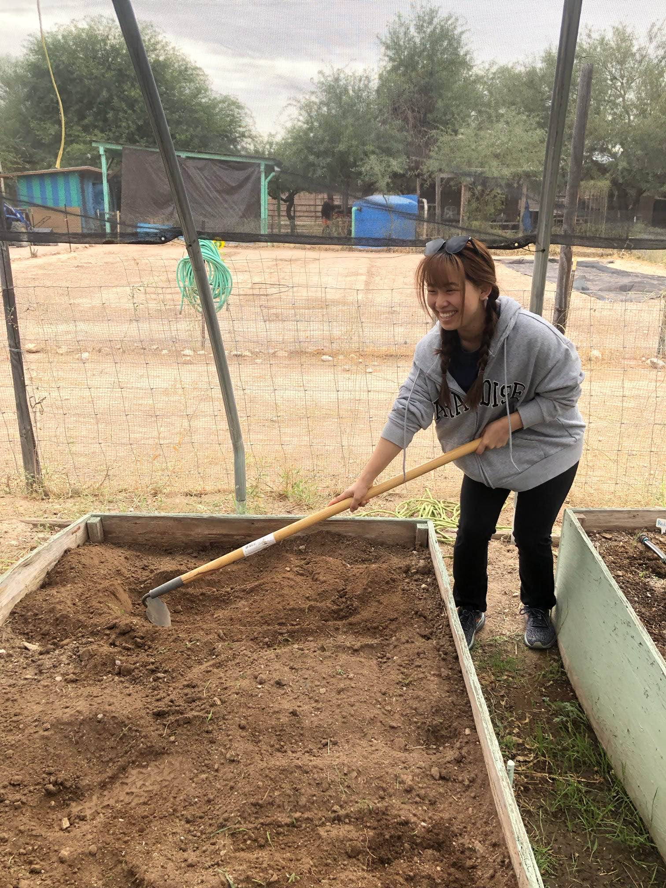
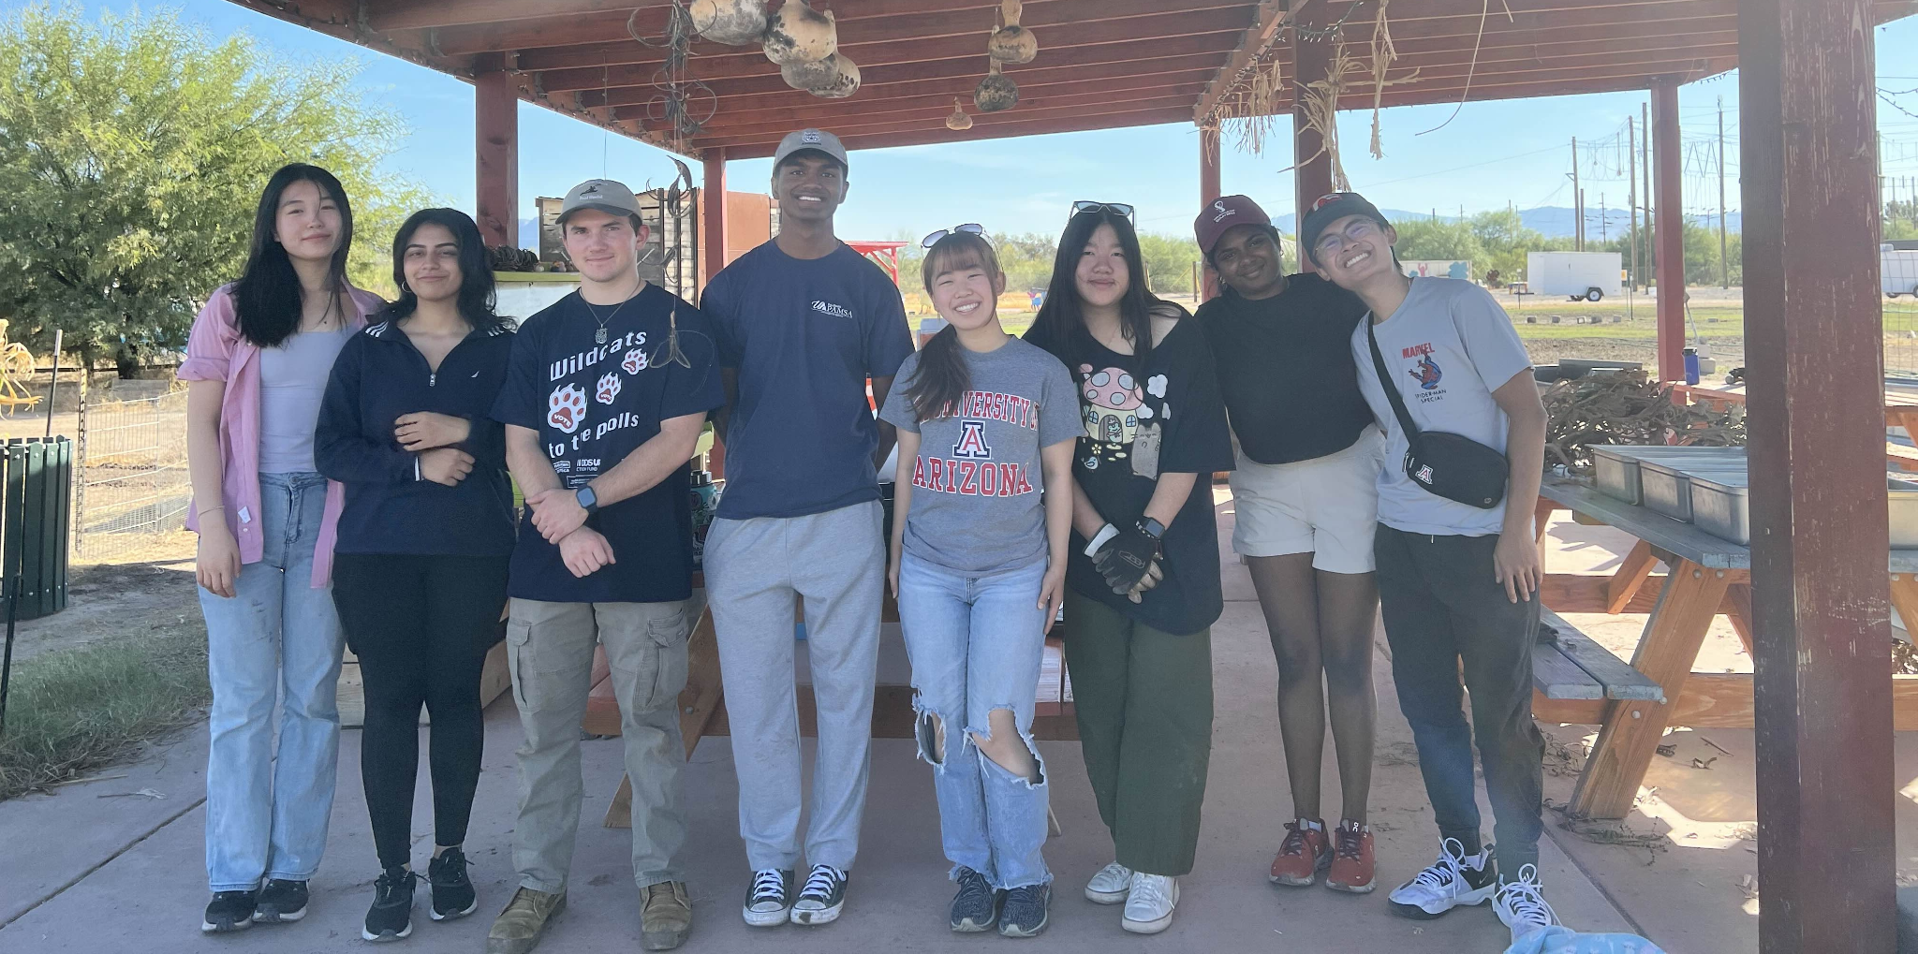
Volunteering
Importance
Examples
Hospital volunteering
(doubles as clinical!!)
Volunteer EMT
Habitat for Humanity
Ronald McDonald House
Volunteering with clubs…DOVO EVENTS!!
Develop some core competencies medical schools look for in applicants, like Service Orientation and Social Skills
Does not have to medicine-related, just something you are passionate about!
Look for opportunities where you can make a direct difference and do consistently over a long period of time
Keep a journal
  Helpful for writing about experiences
Aim for at least 100-200 hrs of meaningful work

Slide 14
Leadership
Importance
Examples
Ability to take initiative
Demonstrates teamwork and collaboration
Strong communication skills
Shows commitment and growth
Leadership opportunities can be healthcare/clinical related, academic, community and service related, etc.
Student Organizations
RA
Peer Mentor
Student Ambassadors
Volunteer organization
Team captain
Student government
TA/Preceptor

Slide 15
Shadowing
Importance
Ways to get shadowing
Personal connections!
Pre med/pre health clubs
Cold email/call!
Shadowing/mentorship programs
Pre meds typically have around 50-100 hours of shadowing
Confirms for yourself that you are actually interested in medicine and healthcare
Exposes you to different specialities and interests
Shows you how doctor-patient relationships develop
Strengthens your application and personal statement

Slide 16

Letters of Recommendation
Importance
Examples
Necessary to your application
  They provide credible insights into an applicant's character, work ethic, and suitability for a career in medicine.
  Only ask people who actually know you
  Connect early!
Minimum amount/writers can vary greatly between schools
  This is why advisors recommend
Professors
Science or Humanities
Academic Advisor
Work supervisor
Principal Investigator
Doctor
  Shadowed
  Worked with
Principal Investigator (Research)

Slide 17
Personal Statement, Secondary, Interviews
Personal Statement
Why medicine/why physician
Be authentic and true to yourself
What activities/experiences led you to medicine
Chronological
Keep a general theme
Pls get it reviewed
Secondaries
Specific prompts from each school that you applied to
Received after submitted primary
Main prompts : “why us,” diversity, gap year, leadership, adversity
Interview
Review common interview questions
Review format, traditional vs MMI
Review your application
Review medical ethics
Relax and be yourself

Slide 18
02
Serious Advice

Slide 19
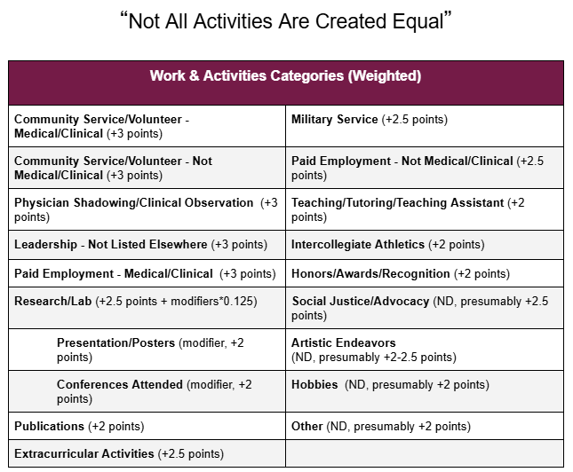
Research research research
Every school has different requirements
Casper, PREVIEW
MD,DO, TX, Caribbean
AAMCAS, AAMCOMAS, TMDSAS

Slide 20
Continued
Please don’t lie on application
Hobbies!
Do nottt gatekeep stuff from other students
Reddit..
  Take with a grain of salt
Gap year
“Ideal Applicant”
  Don’t chase stats and activities just because people say you can’t get in without
  Different schools focus/look for different qualities in applicants
  Does not make you any less of a physician

Slide 21

ACTIVITY: Applying to Medical School
03

Slide 22
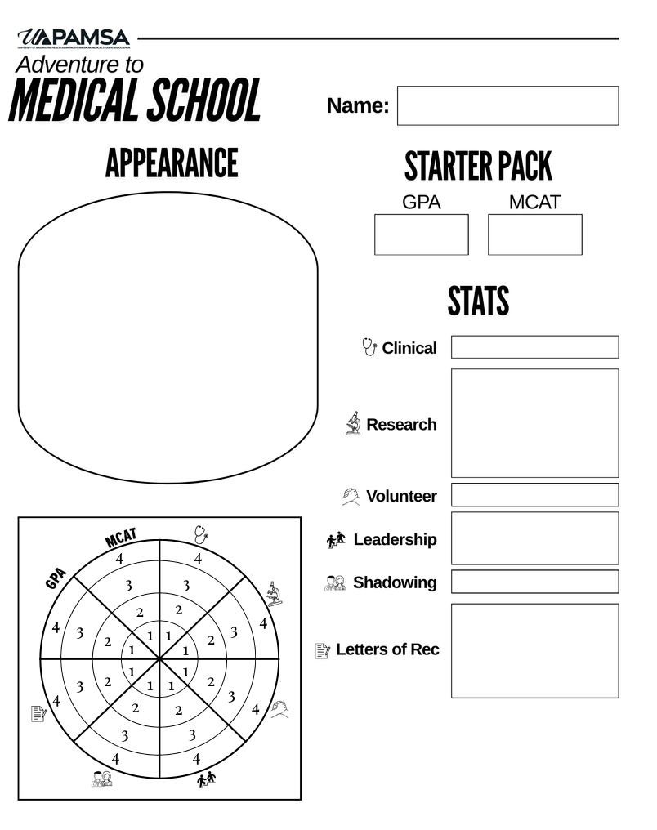
Activity!
Currency
You have 20 points to spend
Chart
Color in the corresponding chart portion for that category
Write short description
Strategy
Build a strong applicant depending on the school are you assigned to

Slide 23
Announcements

Slide 24
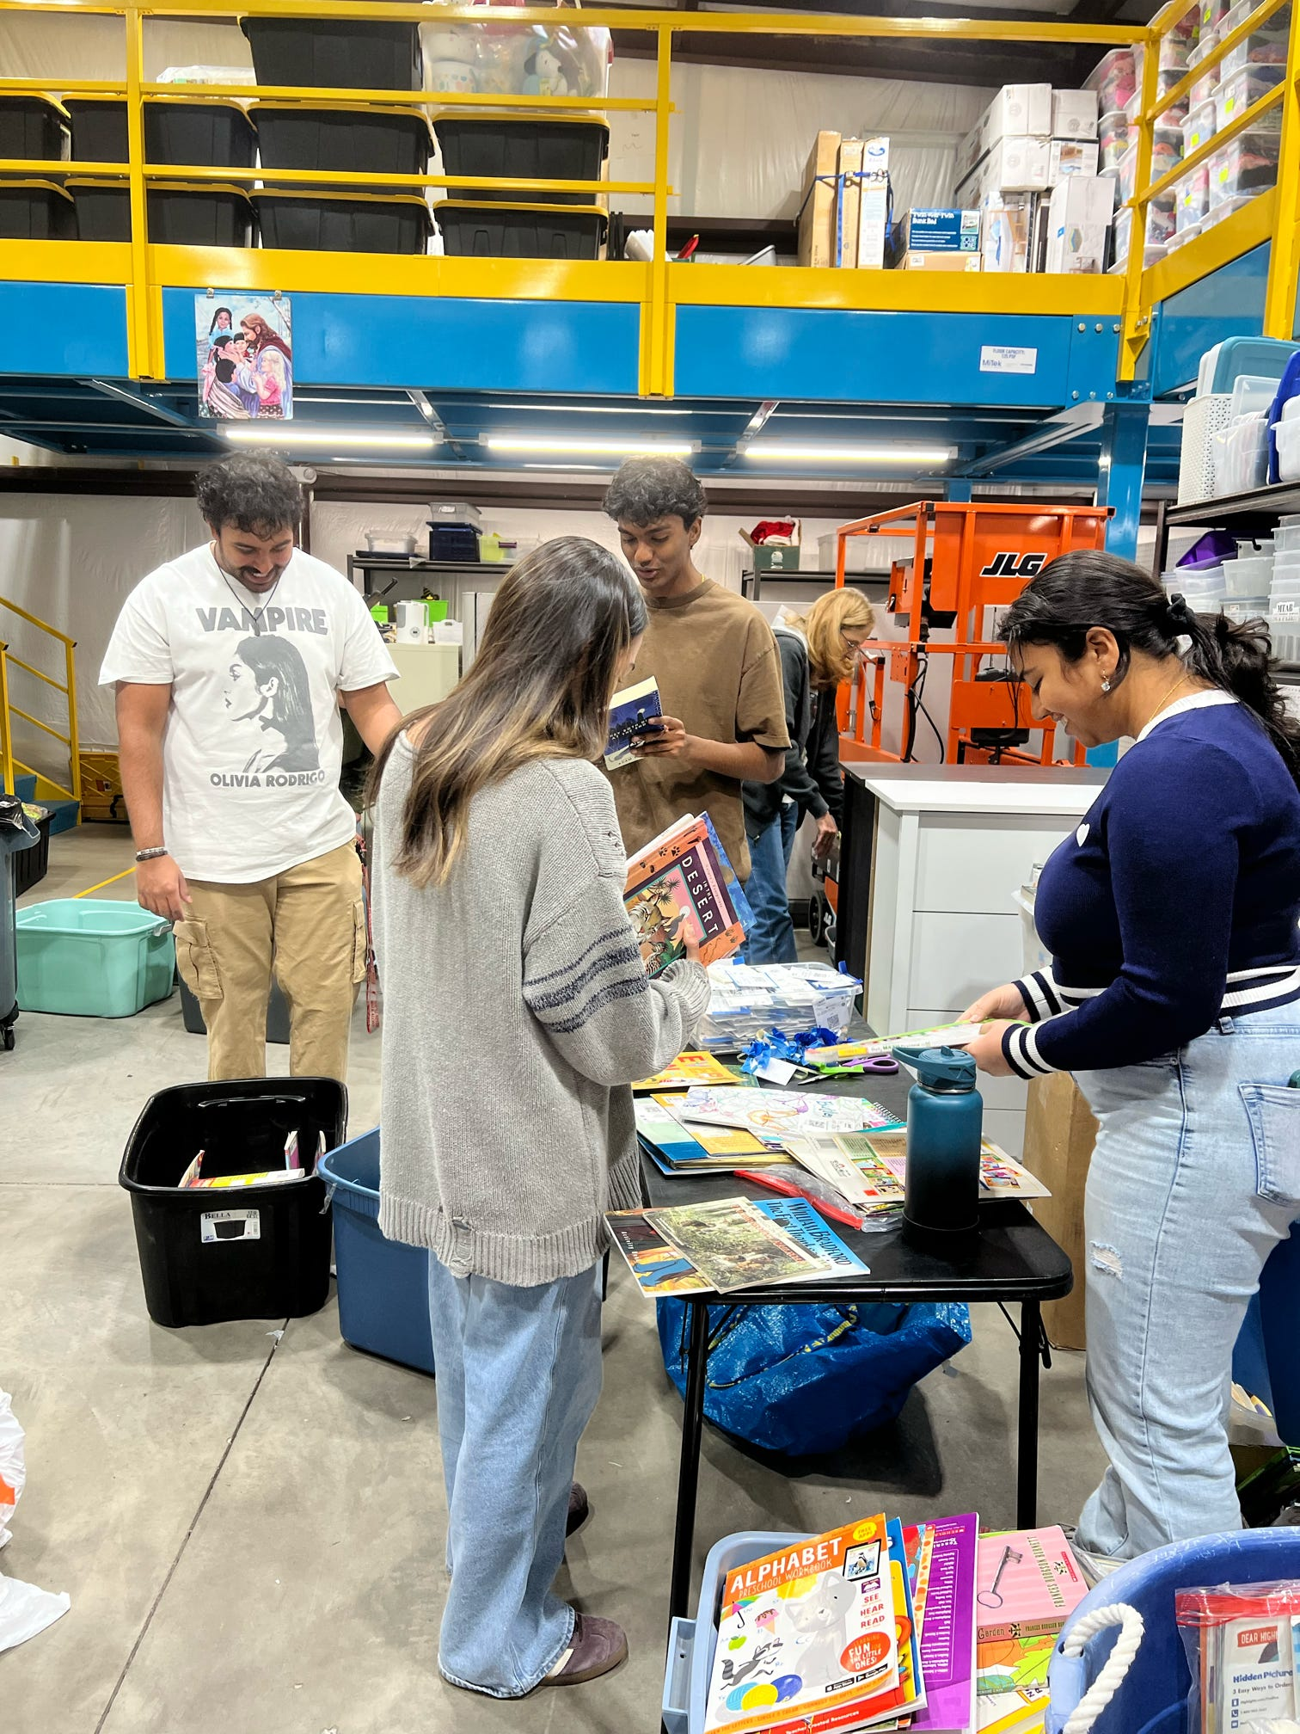
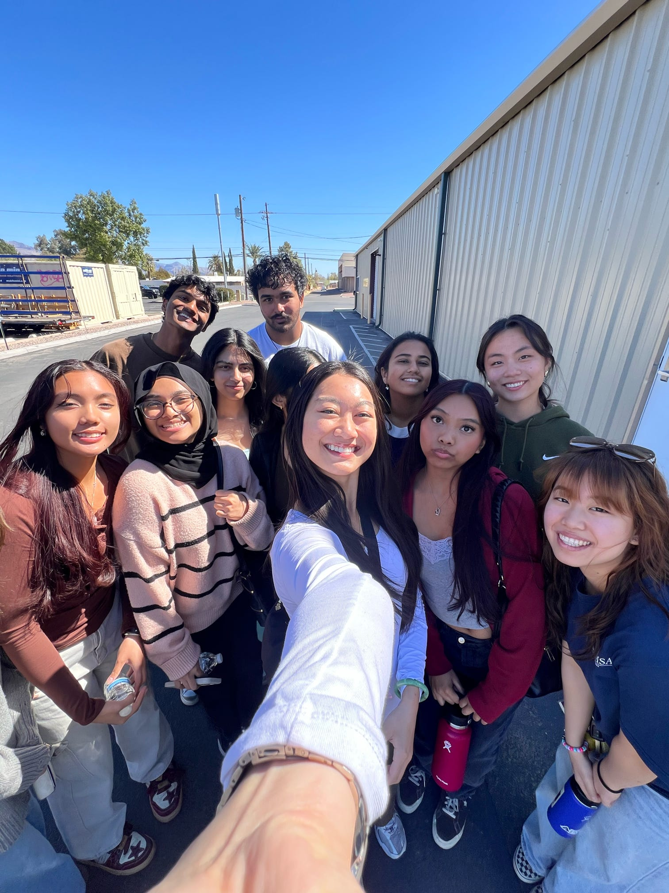
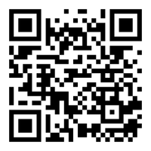
VOLUNTEER OPPORTUNITY!!!!!
Come join us on Saturday, 10/18 from 8:30 AM - 12:30 PM to volunteer at More Than A Bed and help foster families in need!

Slide 25
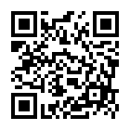
MENTORSHIP PROGRAM - last chance!
Get matched with a mentor who is currently in the field of your intended healthcare field!
Is MD or DO your ultimate goal? Talk to someone currently in medical school!
Looking into a PharmD or BSN? We have mentors for you!
Reach out to Megan Dowd (medowd@arizona.edu // 623-227-6694) if you have any questions!
APPLICATION/COMMITMENT FORM ^^

Slide 26
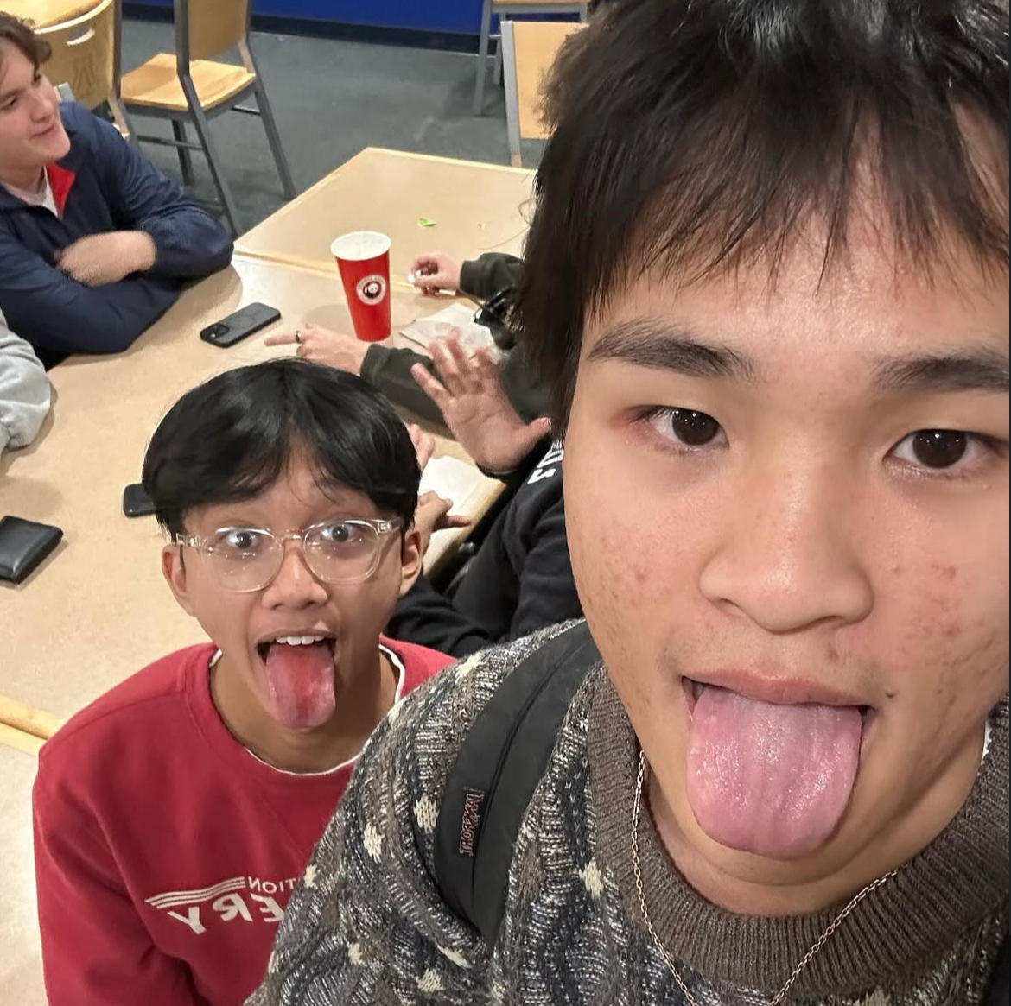
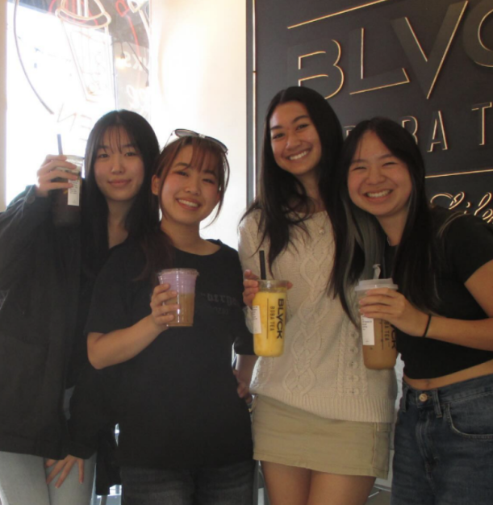
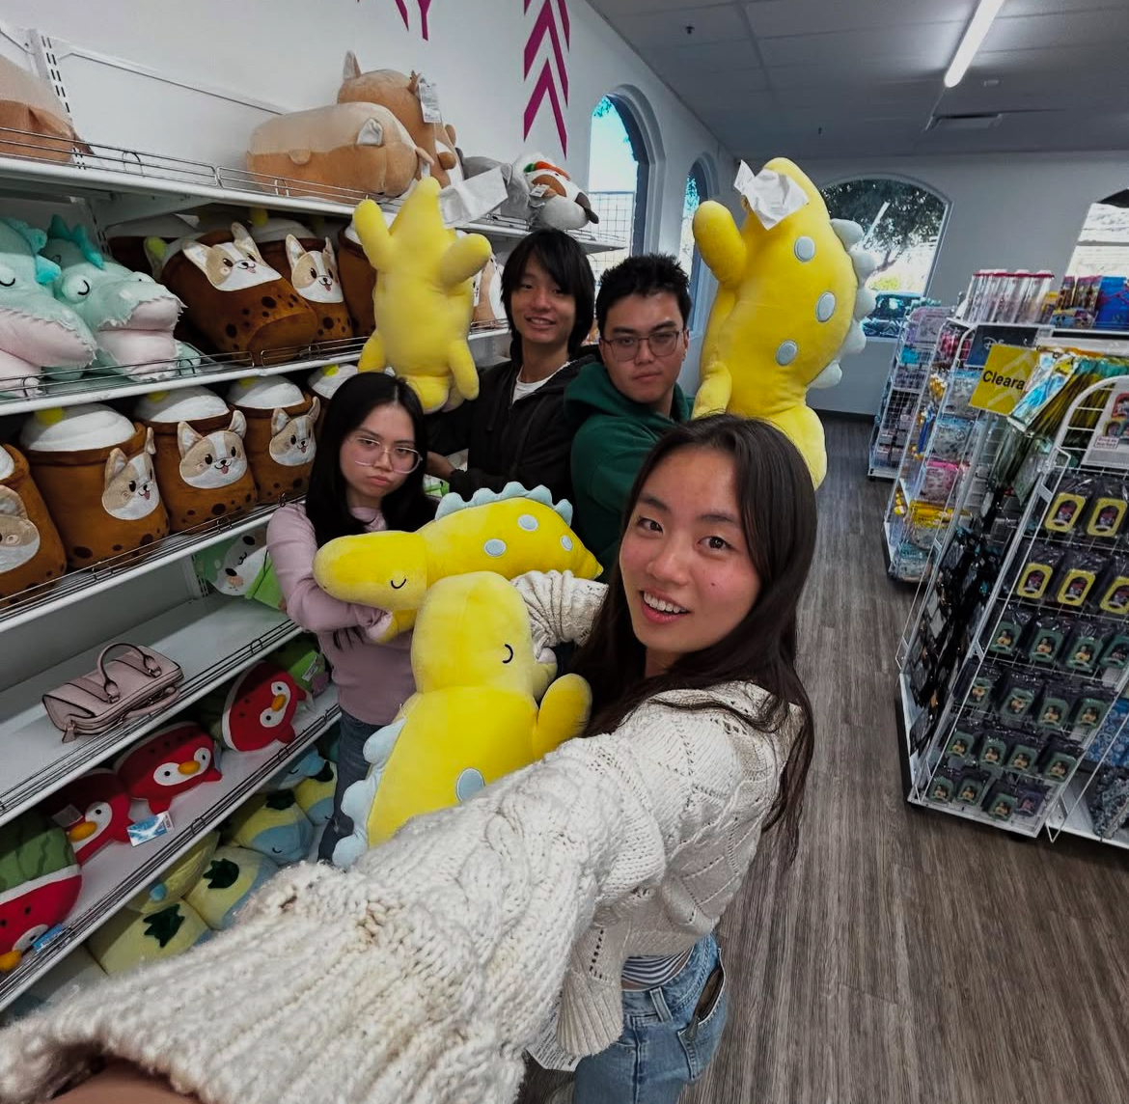
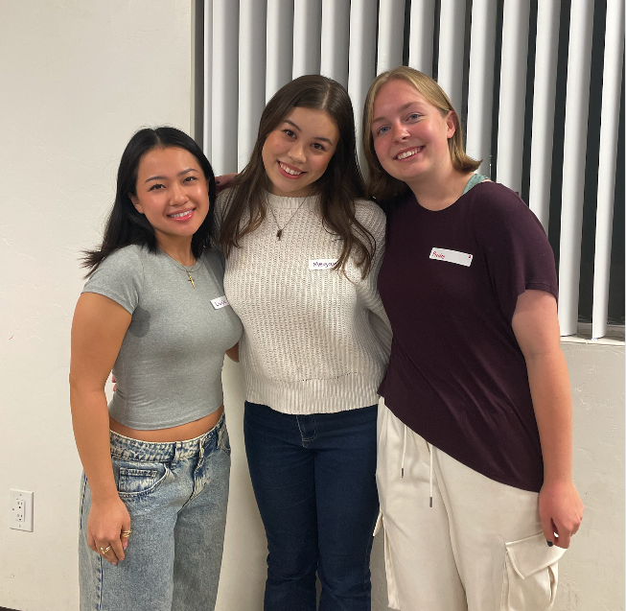
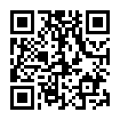
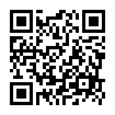
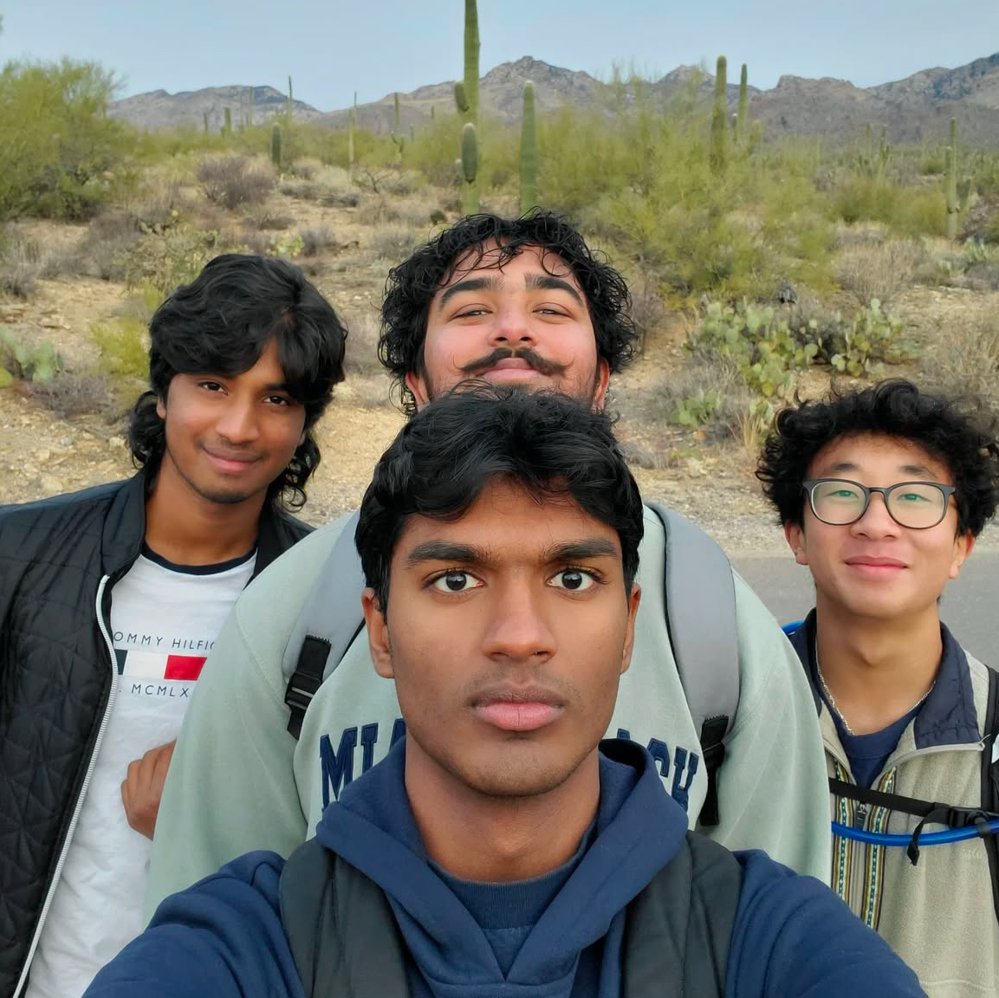
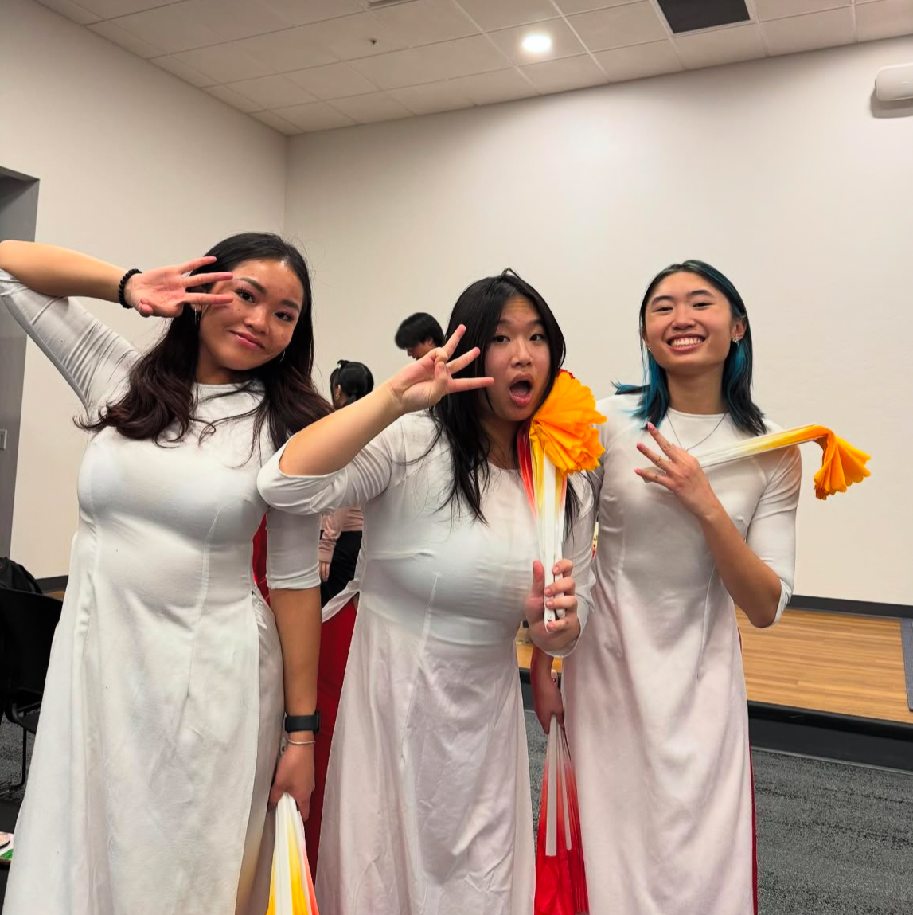
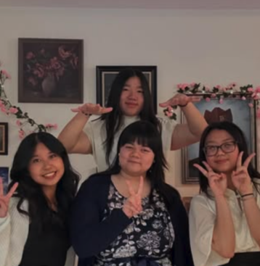
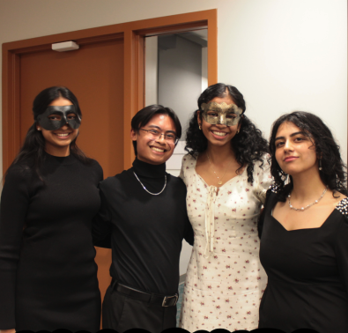
AFAMSA (big-little) PROGRAM
BECOME A BIG
BECOME A LITTLE
reach out to megan (medowd@arizona.edu // @medowd_) for any questions!

Slide 27
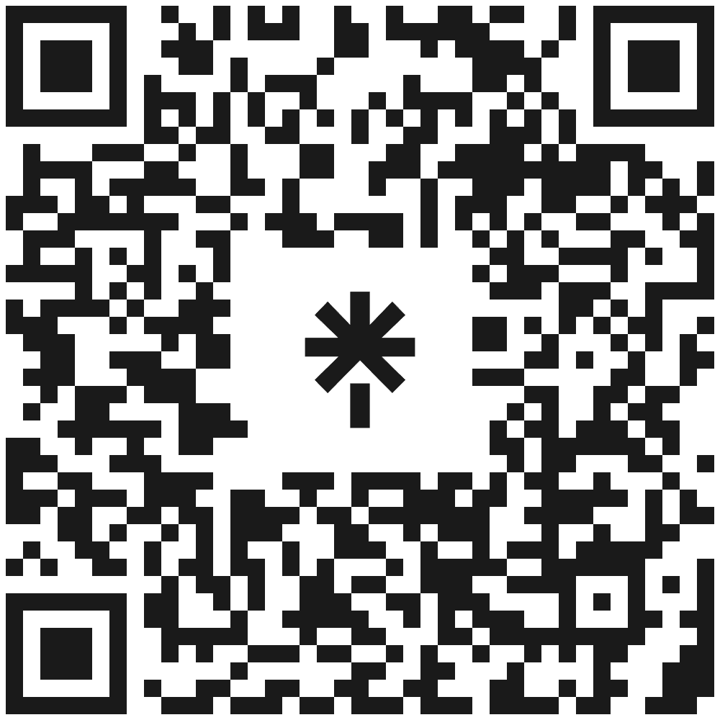
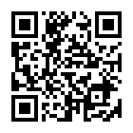
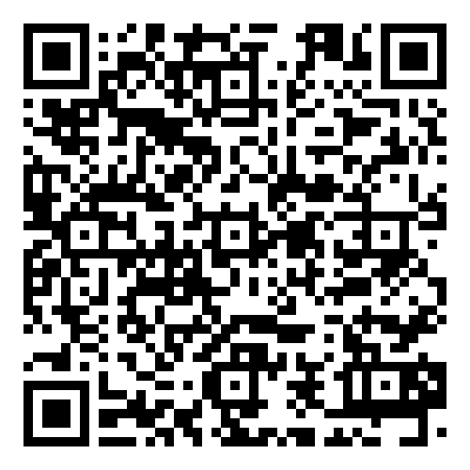

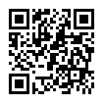
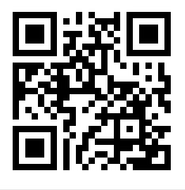
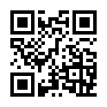
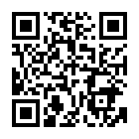




YOU KNOW WHERE TO FIND US!
LinkTree
APAMSA Memories
Resources galore AND latest APAMSA updates!
Photos!
(Updated after every event)

Slide 28
WHOA!
This can be the part of the presentation where you introduce yourself, write your email…

Slide 29
HISTORY OF THIS DAY
1991
2000
2015
2021
NEPTUNE
VENUS
MARS
JUPITER
Neptune is the farthest planet
from the Sun
Venus is the second planet from the Sun
Despite being red, Mars is a cold place
Jupiter is the biggest planet of them all

Slide 30
WHY DOCTOR’S DAY IS CELEBRATED ON JULY 1ST?
BIRTH ANNIVERSARY DR. BIDHAN CHANDRA YADAV
DEATH ANNIVERSARY DR. BIDHAN CHANDRA YADAV
Mercury is the closest planet to the Sun and the smallest one in the Solar System—it’s a bit larger than the Moon
Venus has a beautiful name and is the second planet from the Sun. It’s hot and has a very poisonous atmosphere

Slide 31
DR. BIDHAN PERSONALITY
MERCURY
JUPITER
Mercury is a very small planet
It is the biggest planet of them all
SATURN
MARS
Saturn is a gas giant and has rings
Mars is actually a very cold place
VENUS
NEPTUNE
Venus has beautiful name
Neptune is far away from the sun

Slide 32
WHO WAS DR. BIDHAN?
ACADEMICIAN
PHYSICIAN
POLITICIAN
Mercury is the closest planet to the Sun and the smallest of them all
Venus has a beautiful name and is the second planet from the Sun
Despite being red, Mars is actually a cold place. It’s full of iron oxide dust

Slide 33
JOURNEY OF DR. BIDHAN
Venus has a beautiful name
Mercury is a small planet
1901
1923
1882
1911
1961
Mars is a very cold place
Only Saturn
has rings
Neptune is an ice giant

Slide 34
3,459
1,743
5,789
VENUS
Venus has a beautiful name but it’s hot
MARS
Despite being red, Mars is actually cold
MERCURY
Mercury is the closest planet to the Sun

Slide 35
HE ESTABLISHED MANY HEALTHCARE FACILITIES
CHITTARANJAN SEVA SADAN
JADAVPUR TB HOSPITAL
KAMALA NEHRU HOSPITAL
VICTORIA INSTITUTION
Venus is the second planet from the Sun
Jupiter is the biggest planet in the Solar System
Despite being red, Mars is actually a cold place
Saturn is a gas giant and has several rings

Slide 36
—SOMEONE FAMOUS
“This is a quote, words full of wisdom that someone important said and can make the reader get inspired.”

Slide 37
KEY NUMBERS
50%
15%
35%
VENUS
JUPITER
MARS
Venus is the second planet from the Sun and has a beautiful name as well
Jupiter is the biggest planet in the Solar System. It is a gas giant too
Despite being red, Mars is actually a very cold place. It is full of iron oxide dust

Slide 38
JULY 1
Indian Doctor's Day is celebrated on this date every single year

Slide 39
INDIA’S LEADING HOSPITAL
100
HOSPITALS
Jupiter is a big planet
210
NABH
Venus has a nice name
320
JCI
Neptune is far away
8100
BEDS
Saturn is a gas giant

Slide 40
HOW TO CELEBRATE IT
HOUR | WHAT | WHERE
10h - 11h | Mercury is the closest planet to the Sun | Mercury
11h - 12h | Venus has a beautiful name but it’s hot | Venus
12h - 14h | Despite being red, Mars is actually cold | Mars
14h -16h | Jupiter is the biggest planet of them all | Jupiter

Slide 41
WAYS TO CELEBRATE
MERCURY
MARS
20%
10%
VENUS
JUPITER
40%
30%
Mercury is the closest planet to the Sun
Despite being red, Mars is actually cold
Venus has a beautiful name but it’s hot
Jupiter is the biggest planet of them all

Slide 42
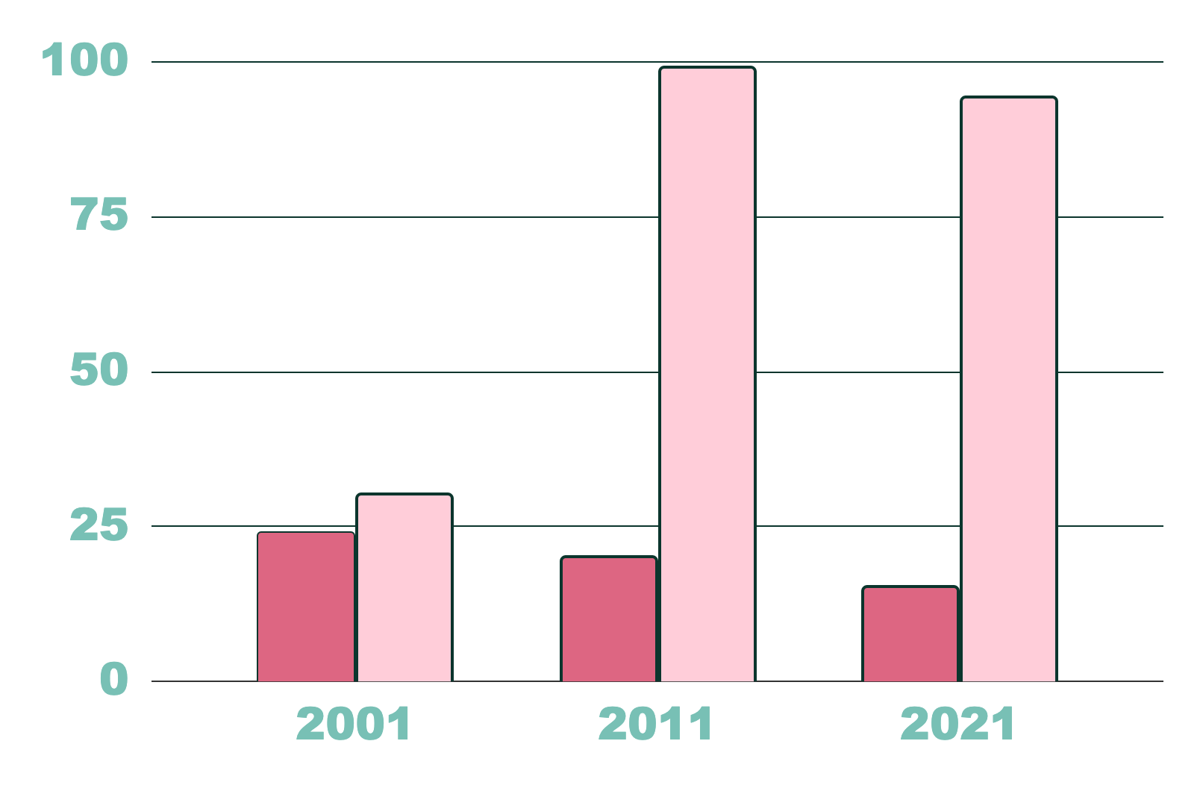
DO YOU NEED A GRAPH?
NORTH INDIA
Mercury is the closest planet to the Sun
SOUTH INDIA
Venus has a beautiful name, but terribly hot
Follow the link in the graph to modify its data and then paste the new one here. For more info, click here

Slide 43
RECOGNIZING THE PHYSICIAN’S CONTRIBUTION IN SOCIETY
MERCURY
MARS
JUPITER
NEPTUNE
SATURN
VENUS
It’s the closest planet to the Sun
Mars is actually a very cold place
Jupiter is the biggest planet of them all
It’s the farthest planet from the Sun
It’s composed of hydrogen and helium
Venus is the second planet from the Sun

Slide 44
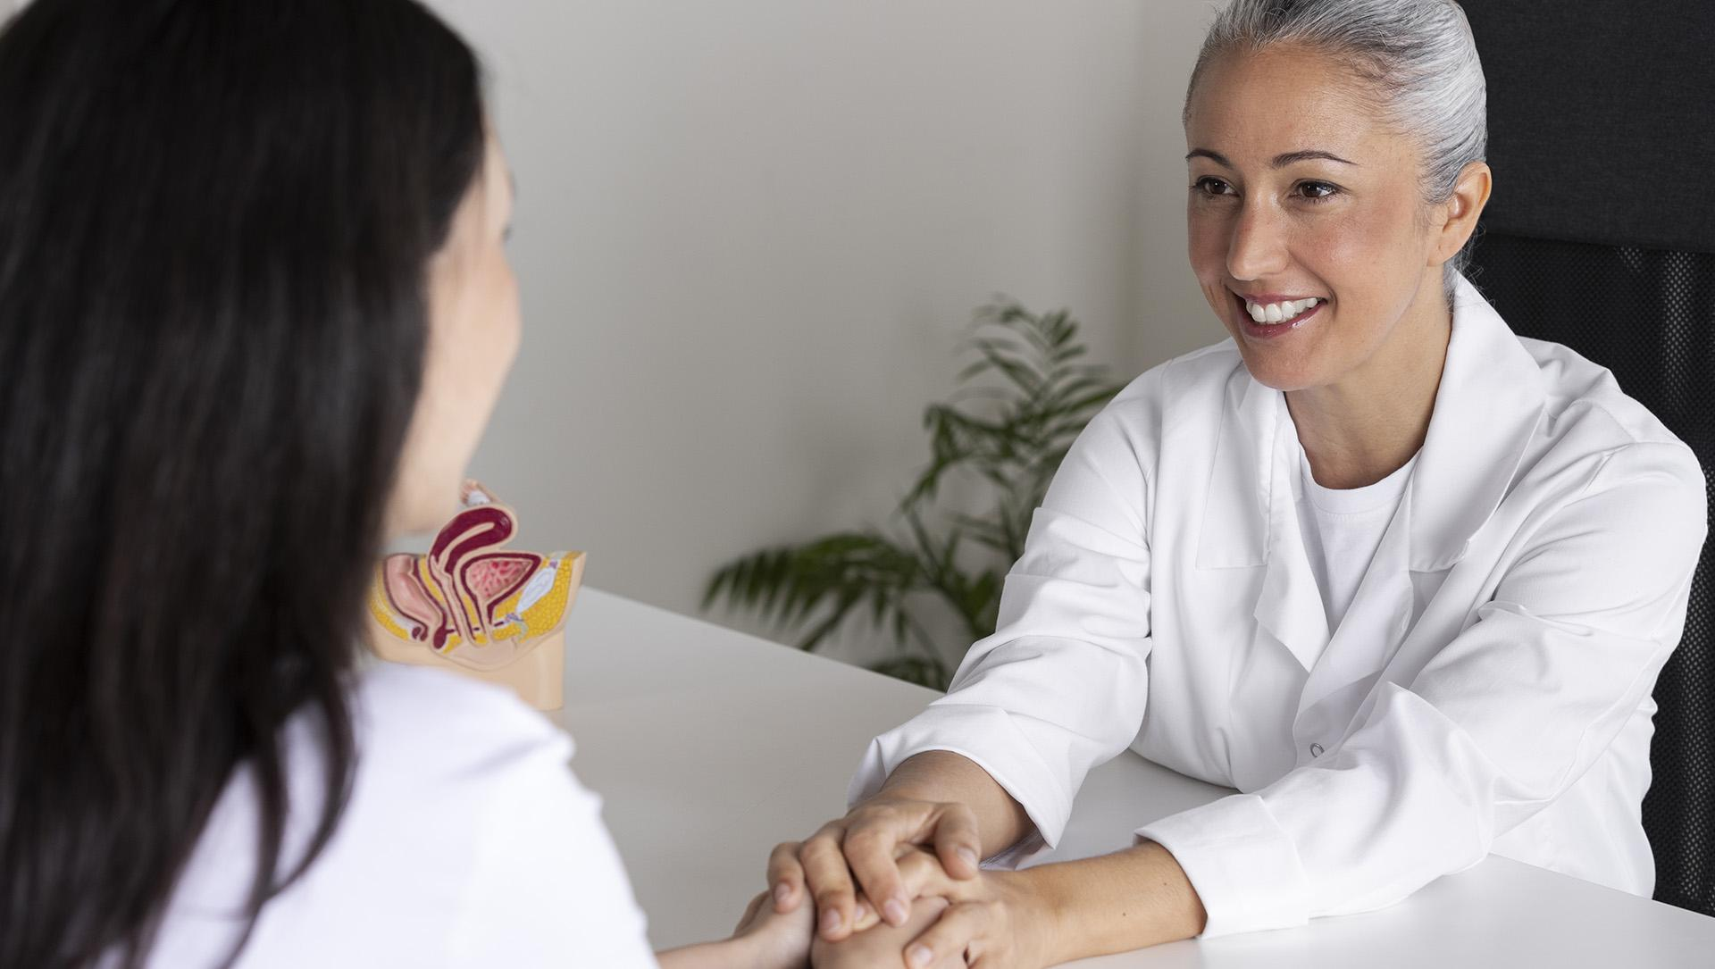
A PICTURE IS WORTH A THOUSAND WORDS

Slide 45
THIS IS AN INFOGRAPHIC
NEPTUNE
MERCURY
SATURN
Neptune is very far from the Sun
Mercury is a very small planet
Saturn is the planet with rings
JUPITER
VENUS
It is the biggest planet of them all
Venus has a beautiful name
MEDICINE IN OUR COUNTRY

Slide 46
DOCTOR’S DAY IN THE WORLD
JUPITER
It is the biggest planet of them all
EARTH
It is the third planet from the sun
SATURN
Saturn is a gas giant and has rings

Slide 47
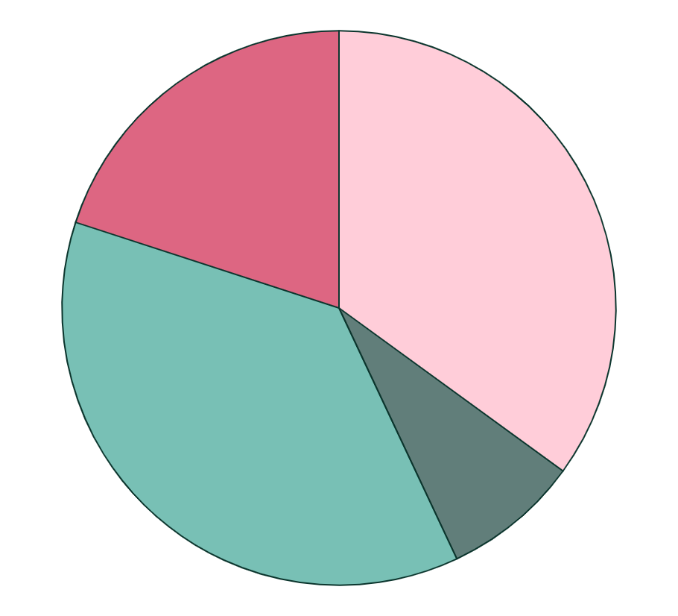
MEDICAL SPECIALITIES IN INDIA
20%
35%
OBSTETRICS
DERMATOLOGY
Venus has a beautiful name but it’s hot
Jupiter is the biggest planet of them all
35%
10%
ORTHOPEDICS
PEDIATRICS
Mercury is the closest planet to the Sun
Despite being red, Mars is actually cold
Follow the link in the graph to modify its data and then paste the new one here. For more info, click here

Slide 48
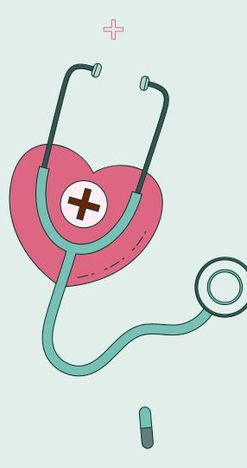
MOBILE WEB
You can replace the image on the screen with your own work. Just right-click on it and select “Replace image”

Slide 49
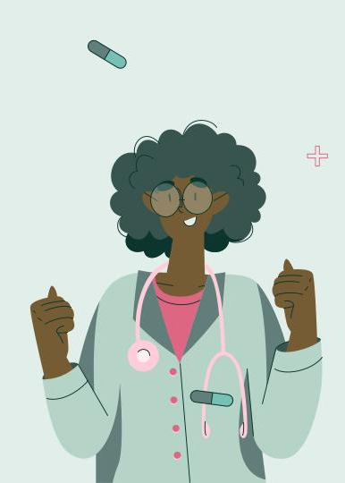
TABLET APP
You can replace the image on the screen with your own work. Just right-click on it and select “Replace image”

Slide 50
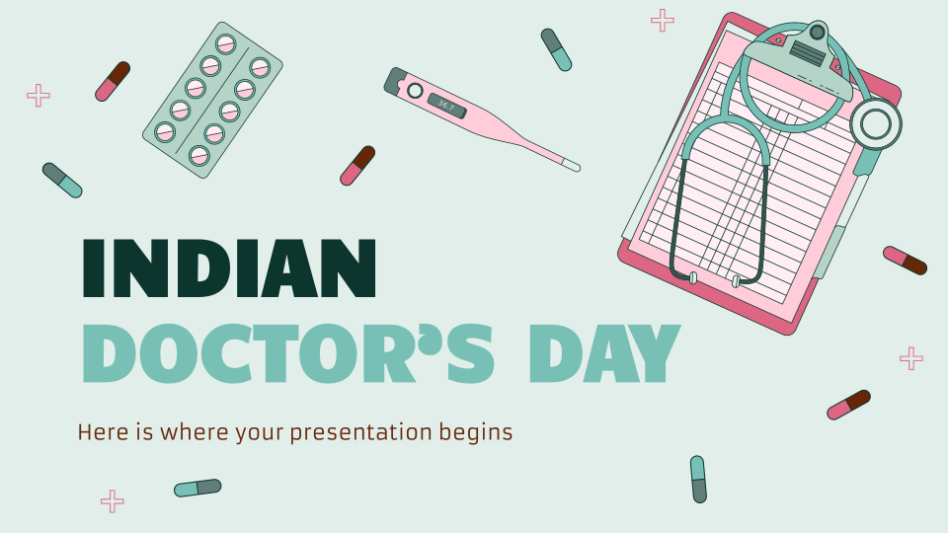
DESKTOP SOFTWARE
You can replace the image on the screen with your own work. Just right-click on it and select “Replace image”

Slide 51

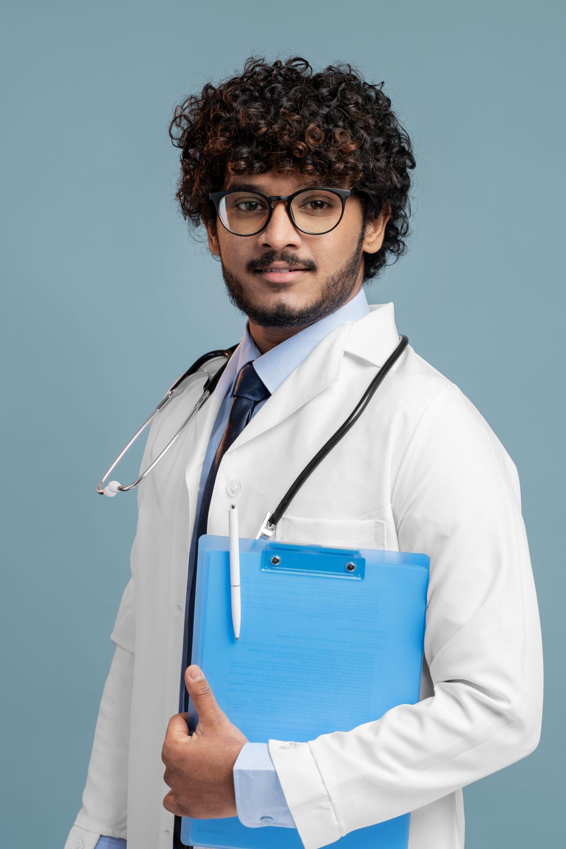
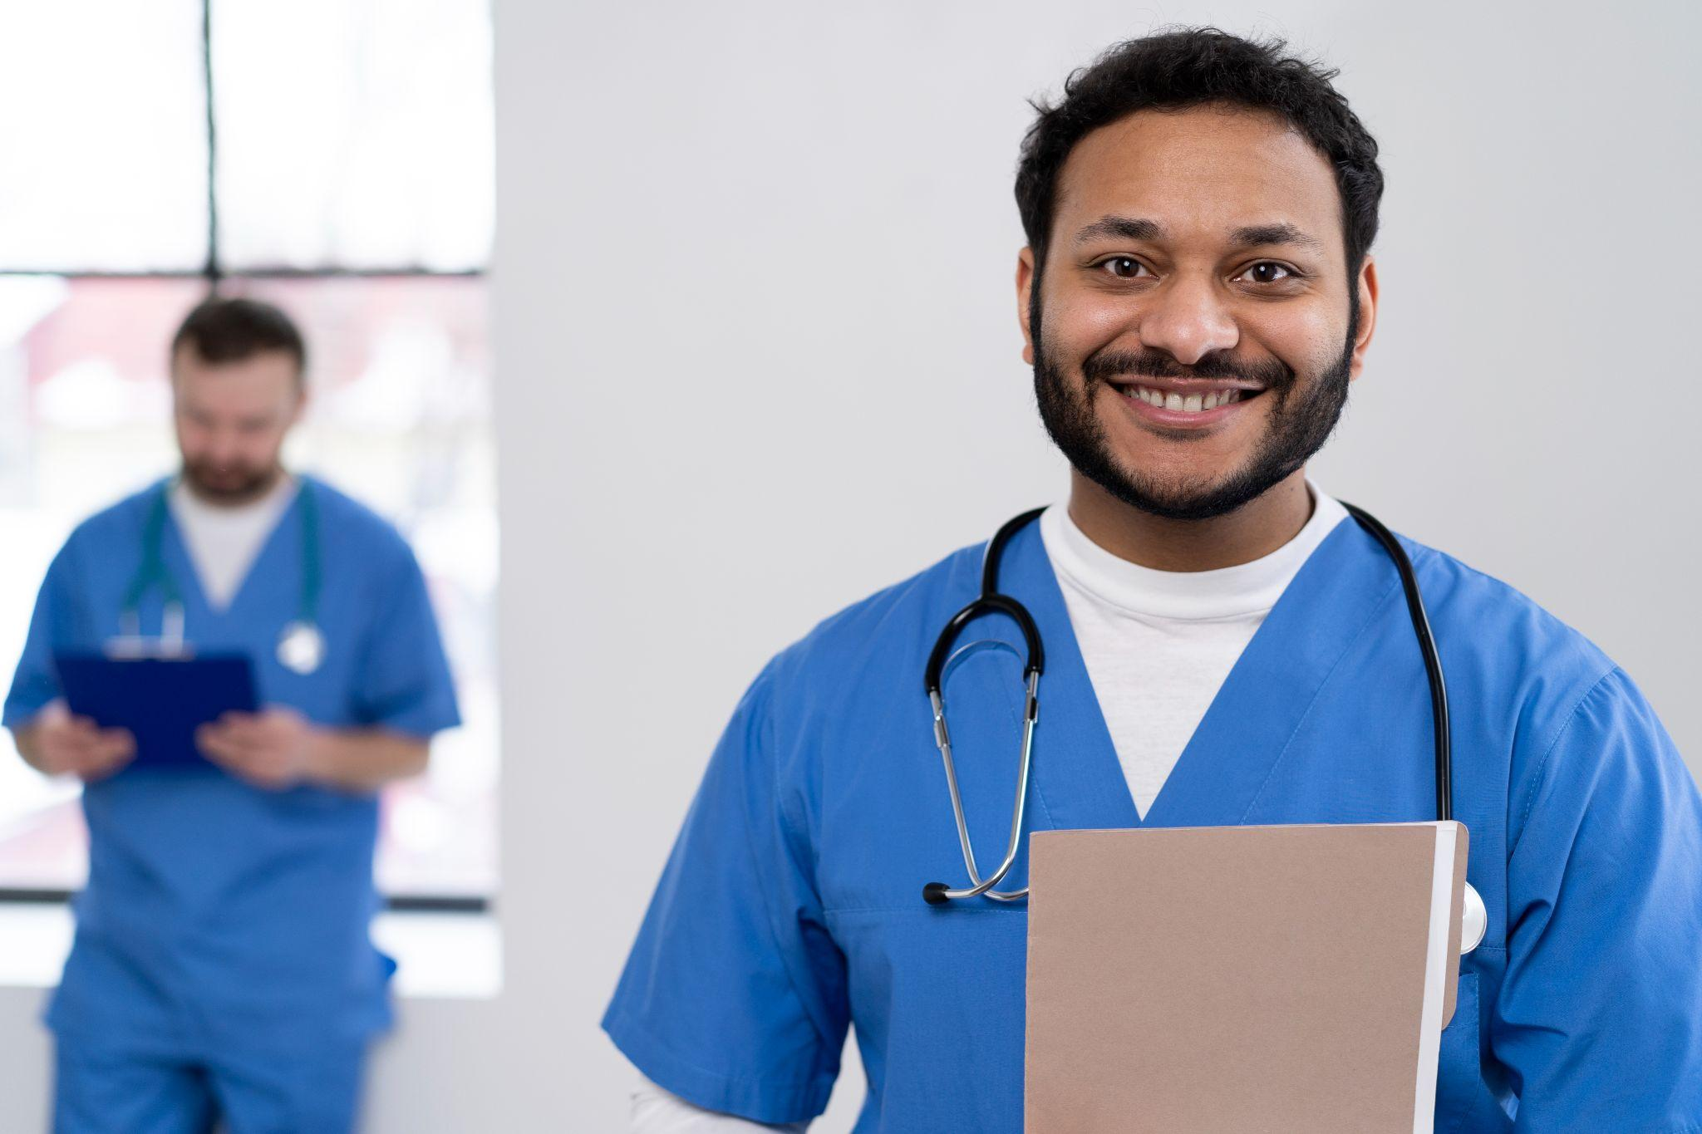
OUR DOCTORS
RANJIT DAS
DEVDAN RAM
ARYA KUMAR
You can speak a bit about this person here
You can speak a bit about this person here
You can speak a bit about this person here

Slide 52
SOME CONCLUSIONS
Write your final conclusions here
Write your final conclusions here
Write your final conclusions here
Write your final conclusions here
Write your final conclusions here
Write your final conclusions here
Write your final conclusions here

Slide 53
THANKS!
Do you have any questions?
youremail@freepik.com
+91 620 421 838
yourwebsite.com
Please keep this slide for attribution

Slide 54
ALTERNATIVE RESOURCES
Here’s an assortment of alternative resources whose style fits the one of this template:
Hand drawn flat world aids day
Hand drawn flat world health day illustration I
Hand drawn flat world health day illustration II

Slide 55
RESOURCES OF THIS TEMPLATE
VECTORS
Hand drawn flat world health day illustration
Hand drawn flat world health day illustration I
Hand drawn flat world health day illustration II
Hand drawn flat world health day illustration III
Hand drawn flat world aids day illustration
PHOTOS
Nurse preparing for consult
Smiley doctor holding patient's hands
Young doctor getting ready for work
Smiley doctor holding clipboard
Nurses getting ready for work day
Did you like the resources on this template? Get them at our other websites

