Slide 1
Resume + LinkedIn Workshop
APAMSA General Meeting 4

Slide 2
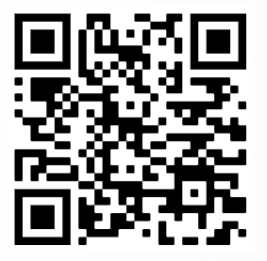
Sign In!

Slide 3
Agenda
01
02
03
04
Icebreaker
Resume
LinkedIn
Announcements

Slide 4
01
Icebreaker!
Networking Bingo

Slide 5
Networking Bingo
Find a different person to sign each box! Once you get bingo, come to the front of the room!

Slide 6
02
Resume + CV
(mostly resumes)

Slide 7
Resume vs. CV
Resume
CV
1 page summary of relevant experiences + skills
Tailored to the position/job
General applications
Thorough description of all of your experiences + skills
Any length, usually multiple pages
Academia/research focused

Slide 8
Purpose of a Resume
First impression for employers
Highlights your value quickly
Gets you to the interview

Slide 9
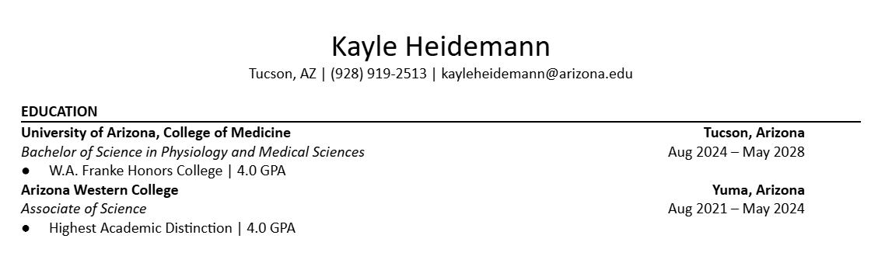
Components of a Resume
Name + Contact Info
Professional Summary (optional + debatable)
Education

Slide 10
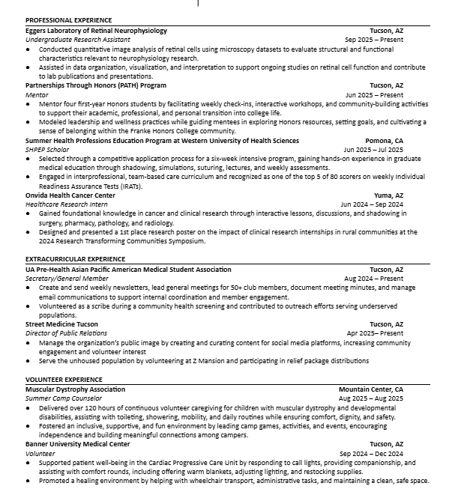
Components of a Resume
Experiences
  Professional Experience
  Work Experience
  Volunteer Experience
  Extracurricular Experience
  Leadership Experience
  Research Experience

Slide 11

Components of a Resume
Awards
Skills
Certifications
Extra Activities

Slide 12
Writing About Experiences
Tips for strong bullets:
Start with a powerful action verb
Be specific and show impact
Use numbers when possible (quantify your results)
Keep it concise: 1–2 lines per bullet
Example:
Weak: “Helped with patients”
Better: “Streamlined patient intake by assisting 10–15 patients daily with paperwork and vital signs, reducing average wait time by 15%.”

Slide 13
Formatting
Use a template
1 page
Clear headings, consistent font & spacing
Reverse chronological order
Bullet points, not paragraphs
Keep it simple!
Avoid flashy designs, fonts, excessive colors or distracting graphics

Slide 14
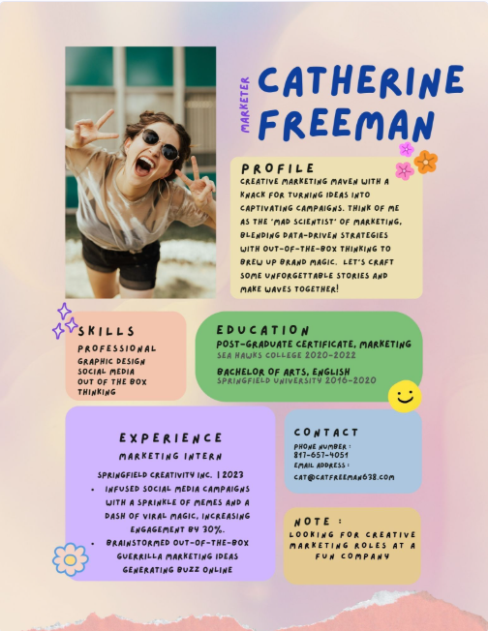
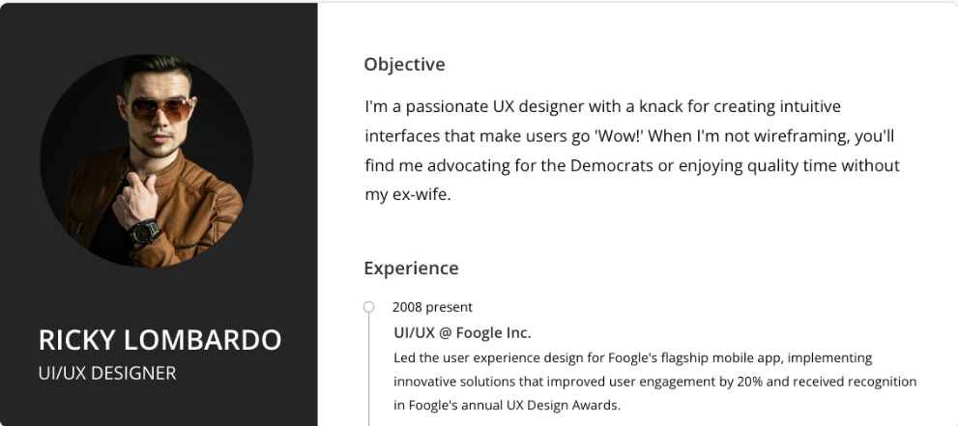
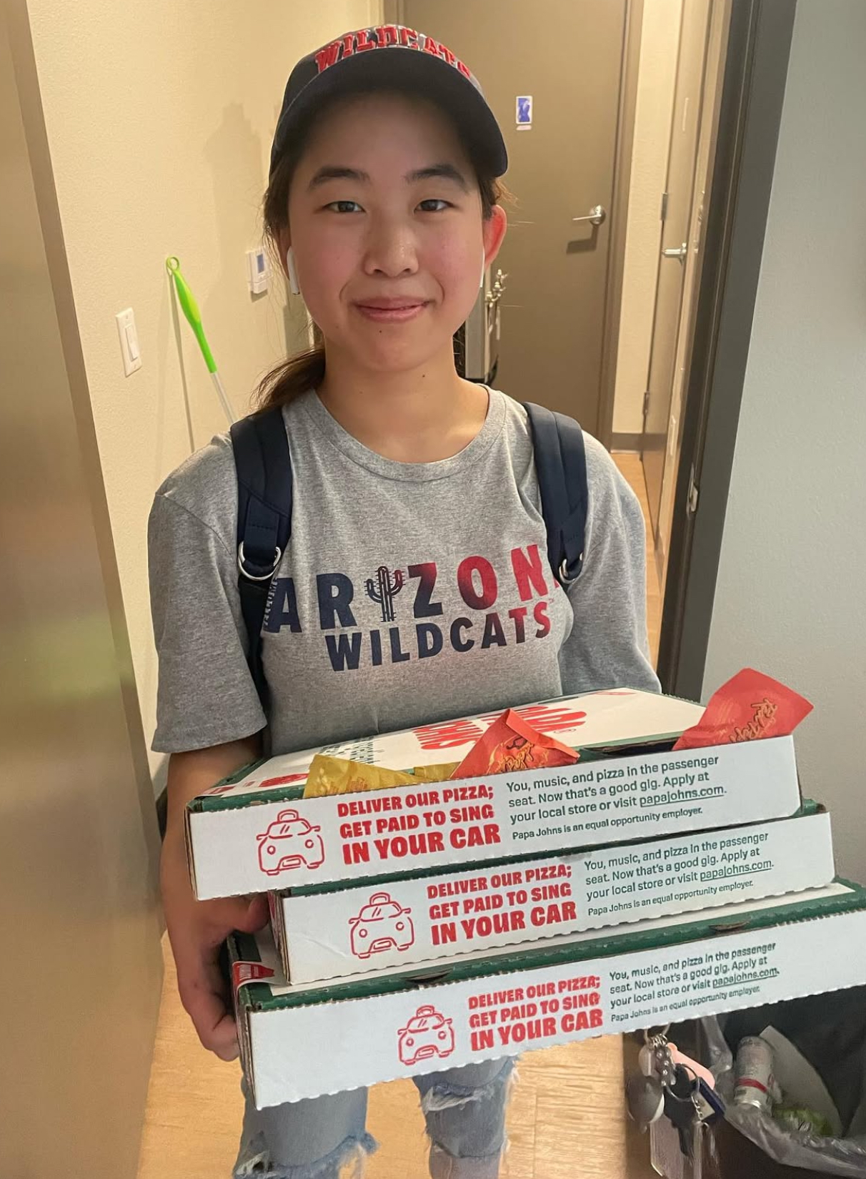
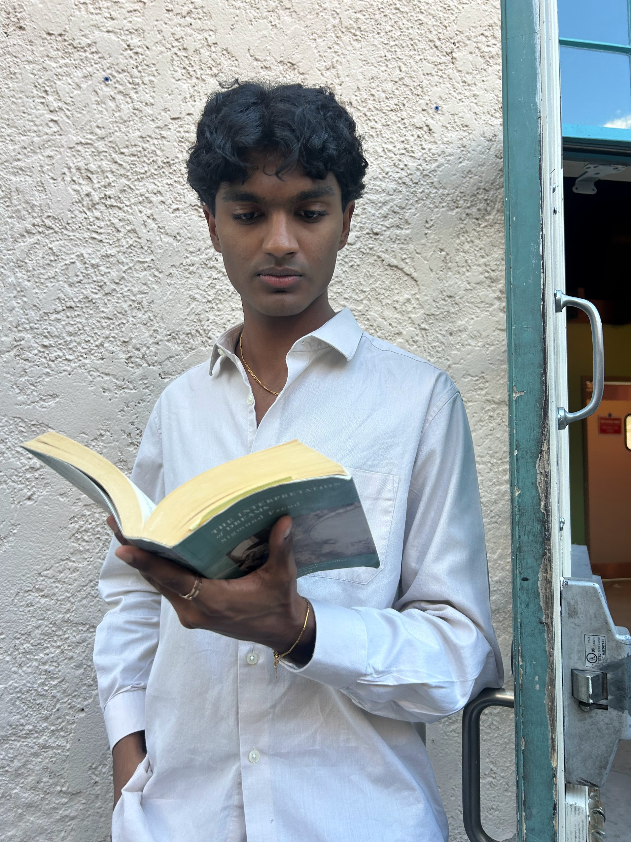
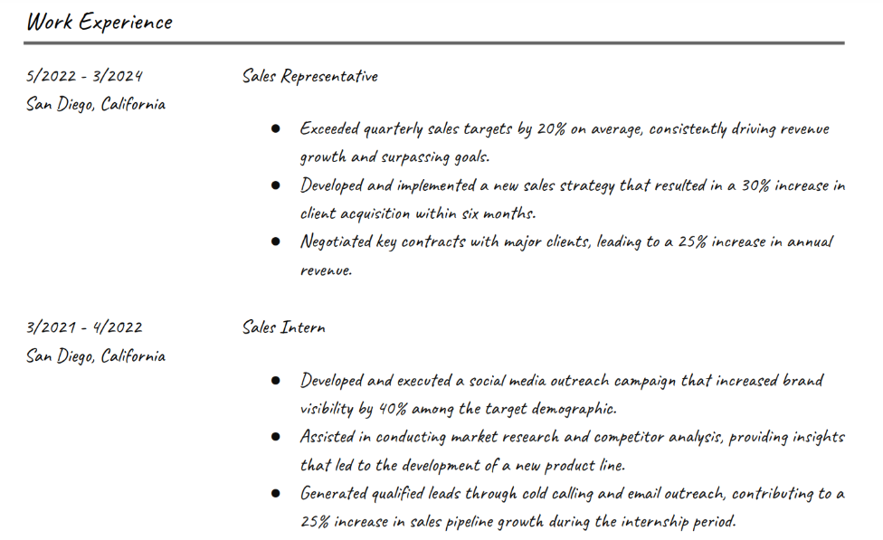
Examples
Carol Chen
feminists
Nikhil Johnson

Slide 15

Examples
Carol Chen
feminists
Nikhil Johnson

Slide 16
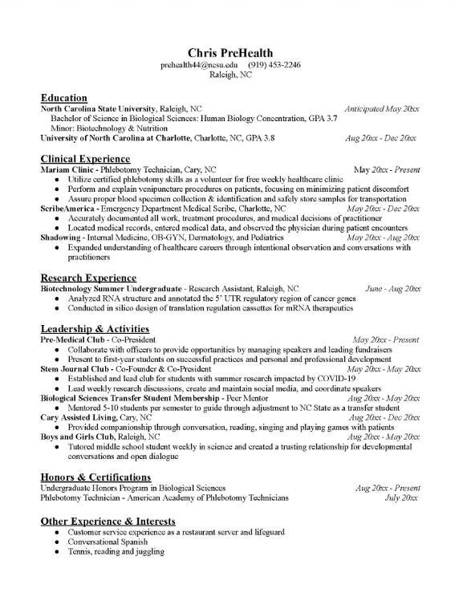
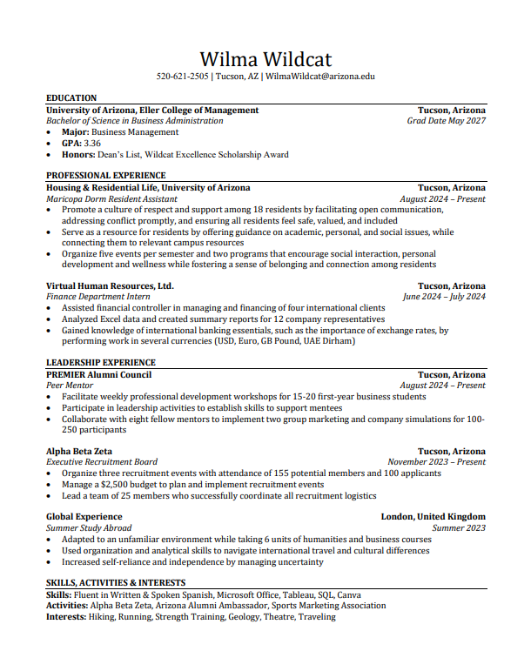
Examples

Slide 17
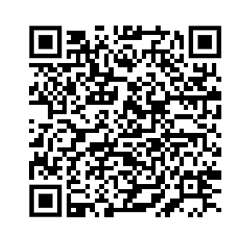
Templates
Search “UA Eller Resume Template”

Slide 18
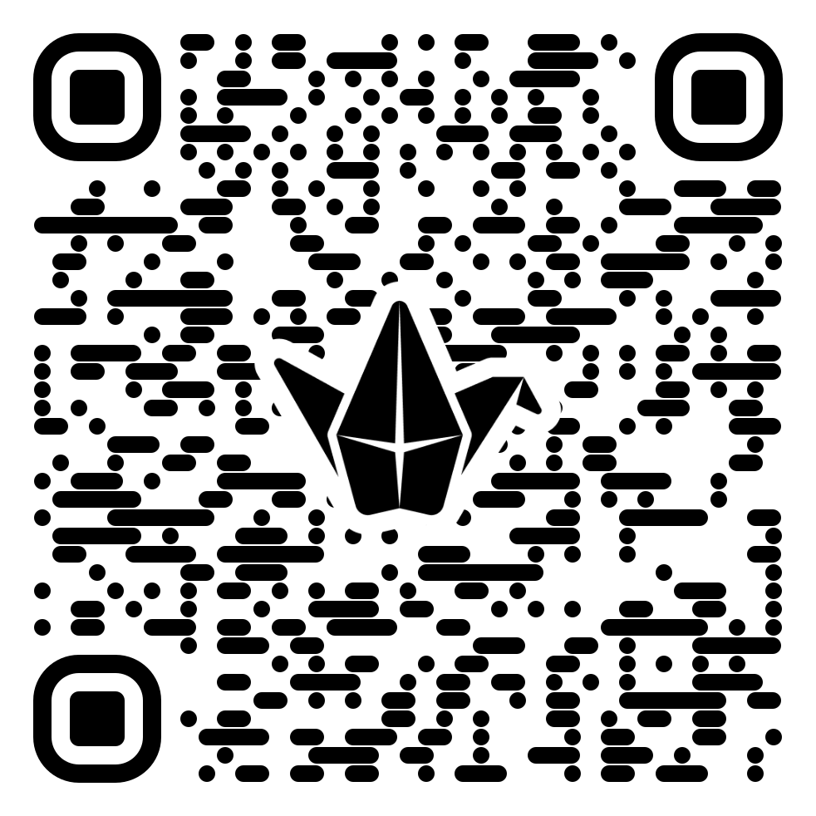
Game Time!

Slide 19
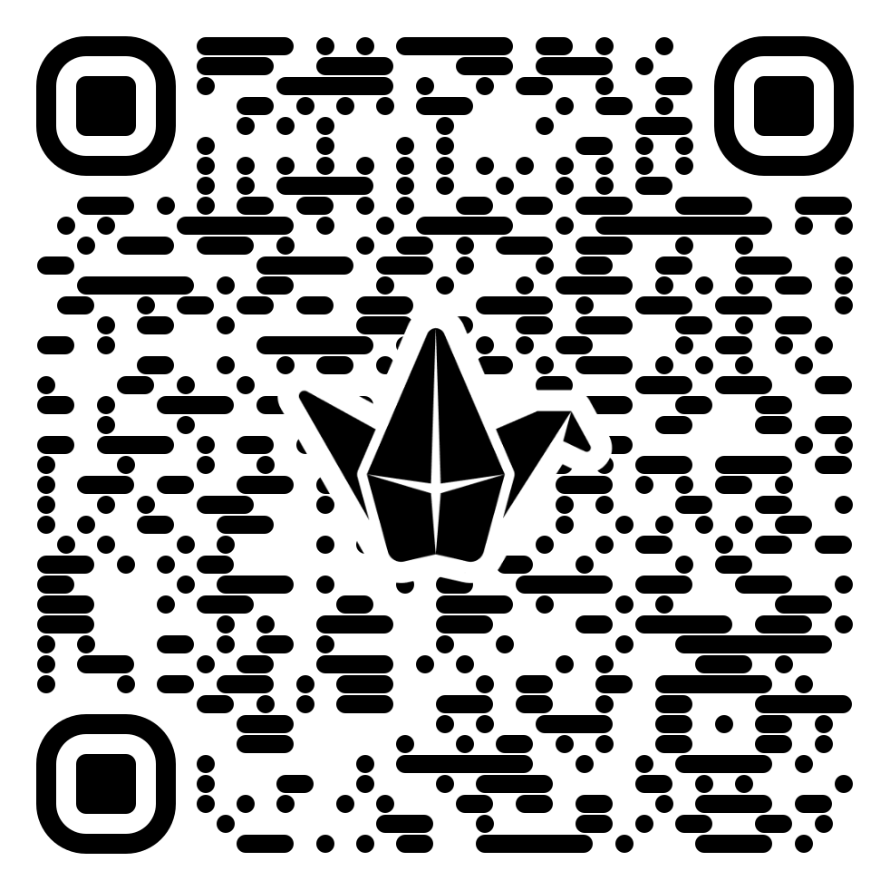
Game Time!

Slide 20

Game Time!

Slide 21
03
LinkedIn

Slide 22

What is LinkedIn?
“Professional Social Media”
Profile to showcase your experience
Gain connections and network with professionals

Slide 23

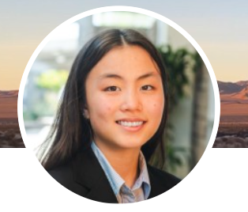
Profile Picture
Should be appropriate and professional
vs.

Slide 24
Headline
The first thing people see
Snapshot of who you are professionally
Concise but specific
Ex. Pre-med Student at University of Arizona | Interested in Public Health & Global Health Equity

Slide 25
About Section
Introduce yourself, your interests, your short and long-term goals
  Are you interested in research? Are you looking for healthcare experience? Is there a specific sector of healthcare that you want to work in?

Slide 26
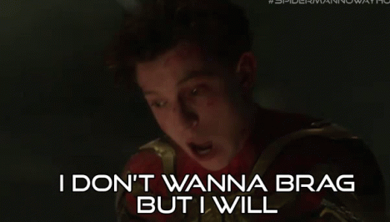
Experiences
List all and any relevant professional experiences
  Do not necessarily have to be jobs
Use strong action verbs and numbers if applicable to highlight your impact in each role
  “Planned APAMSA events” vs “Organized and led 4 events with over 50 people in attendance”
Basically, brag about yourself

Slide 27
Skills and Certifications
Just list all your certifications lol
Technical AND Soft Skills

Slide 28
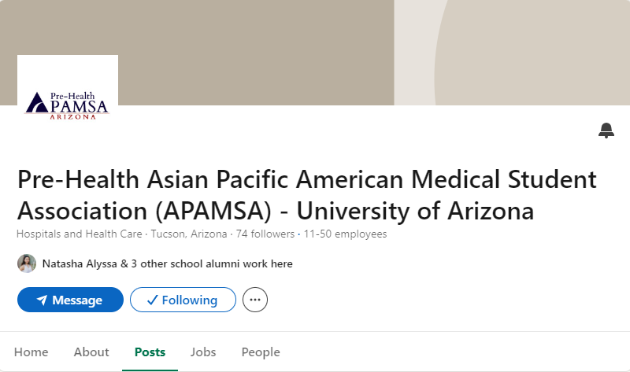
Networking
Connect with a lot of people
Don’t be afraid to message people in your field/interest

Slide 29
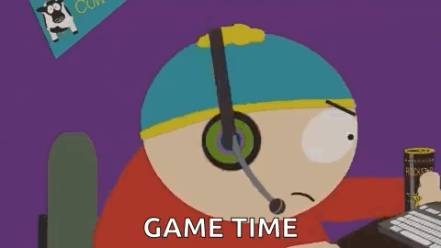
Activity: This vs That

Slide 30
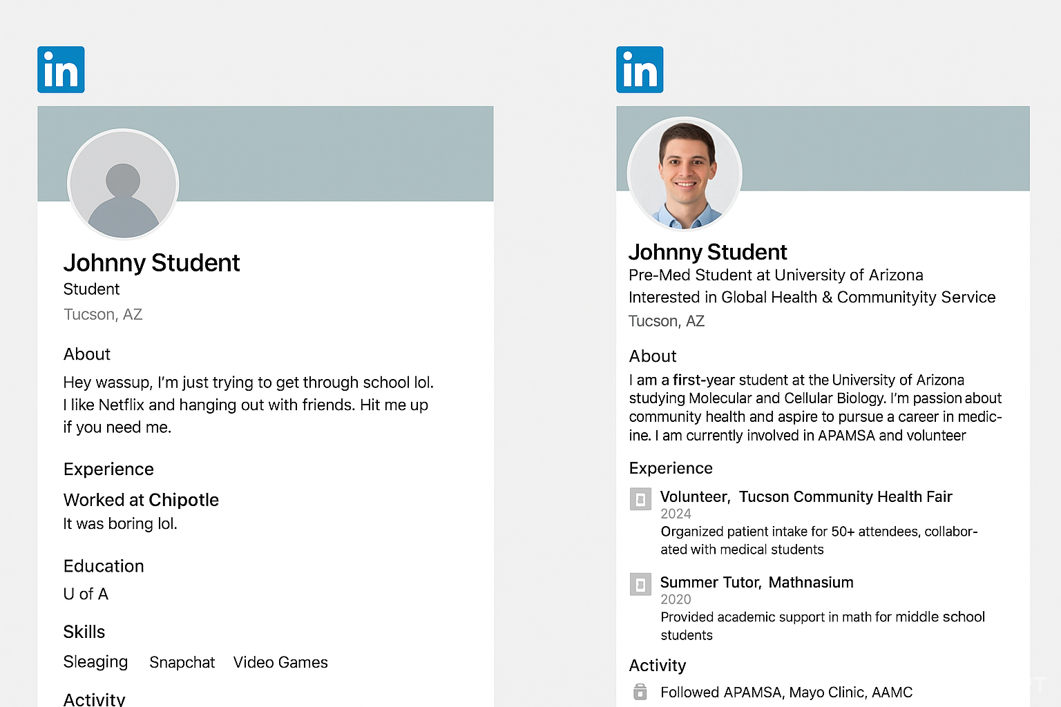

Slide 31
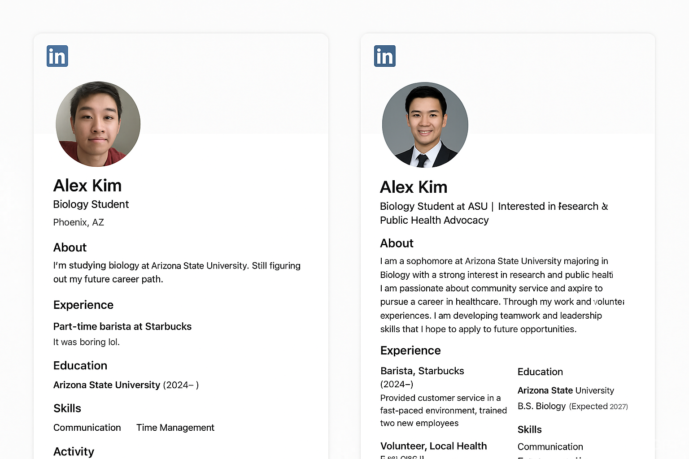

Slide 32
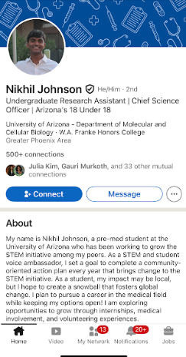
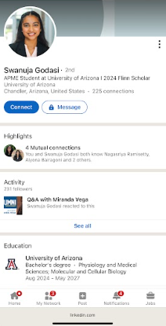

Slide 33
Work Time!!
Work on your own resume
or
Walk around and connect with everyone!

Slide 34
04
Announcements!
Upcoming events

Slide 35
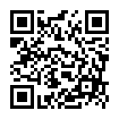
MENTORSHIP PROGRAM
Get matched with a mentor who is currently in the field of your intended healthcare field!
Is MD or DO your ultimate goal? Talk to someone currently in medical school!
Looking into a PharmD or BSN? We have mentors for you!
Reach out to Megan Dowd (medowd@arizona.edu // 623-227-6694) if you have any questions!
APPLICATION/COMMITMENT FORM ^^

Slide 36
Spicy Noodle Competition
Thursday 6pm at APASA!
Be the fastest to eat your spicy noodles for a prize!
$5 buy-in and $1 to sabotage others with Thai Chilis 😈
Regular noodles and icecream will also be sold!

Slide 37

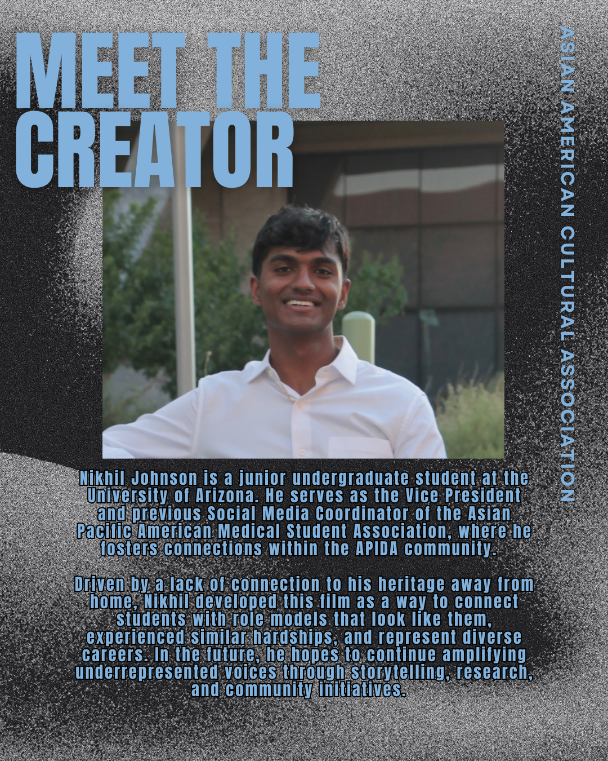
ANNOUNCEMENT FROM AACA

Slide 38

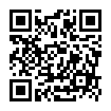
AFAMSA (BIG-LITTLE) MIXER
BIG-LITTLE PONG NIGHT
bigs (SOPHOMORE/JUNIOR/SENIOR) wear neutral colors,
littles (FRESHMAN/SOPHOMORE) wear fun colors
OCT. 3 5-6PM
CHEM 138
SEE U THERE!
fill out interest form PLEASE >>>
reach out to megan (medowd@arizona.edu // @medowd_) or ananya (amogali@arizona.edu // @ananya_gali) if you have any questions!

Slide 39

APASC Committees

Slide 40
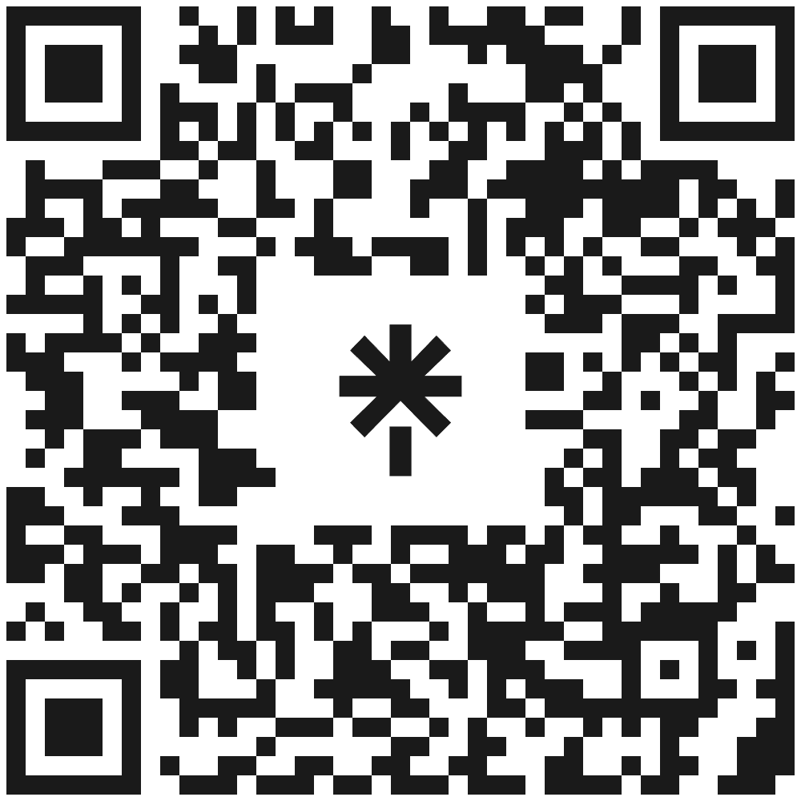
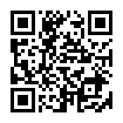
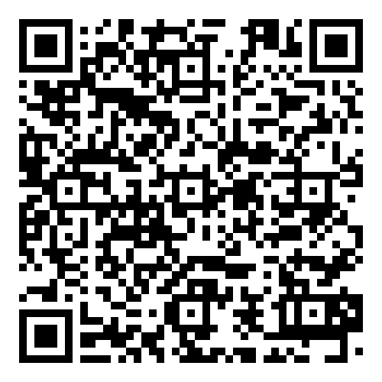

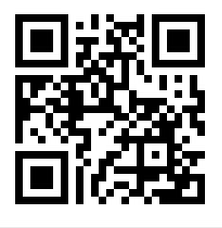
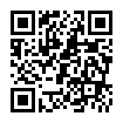
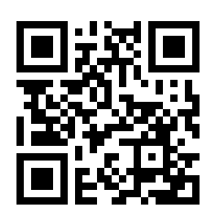
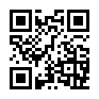
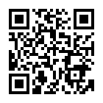




YOU KNOW WHERE TO FIND US!!
LinkTree
APAMSA Memories
Resources galore AND latest APAMSA updates!
Photos!
(Updated after every event)

Slide 41
Thanks!

